Slide 1
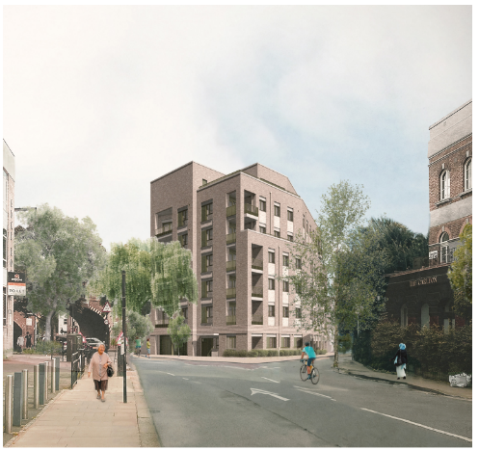
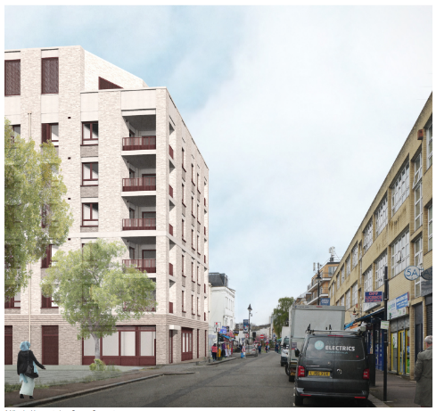


WEST KENTISH TOWN ESTATE
MEET THE CONTRACTOR EVENTS
& CONSTRUCTION MANAGEMENT PLAN CONSULTATION
Artists’ impressions of Site D1 (left) and A1 (right)
Higgins Partnerships and Camden Council invite you to come along to one of our Meet the Contractor events for the estate redevelopment in June 2026.
We will also be consulting on our draft Construction Management Plan for Sites A1 and D1.
VENUE:
104a Queens Crescent, London NW5 4DU
DATES & TIMES:
Tuesday 16 June 2026, 2:00pm – 4:00pm
Thursday 18 June 2026, 5:00pm – 7:00pm
Saturday 20 June 2026, 11:00am – 1:00pm

Slide 2
MEET THE CONTRACTOR & CONSTRUCTION MANAGEMENT PLAN CONSULTATION EVENTS
16, 18 & 20 June 2026
At these events you can:
Meet the team from Higgins Partnerships.
View and comment on our draft Construction Management Plan for Sites A1 and D1.
Find out about our proposals for a Construction Working Group.
Get in touch with us below to find out more.
TRANSLATION?
tradução? traduction?
¿traducción? tłumaczenie?
itumọ? ترجمة؟
| অনুবাদ?
turjumaad? asekyerɛ?
LARGE PRINT?
0207 974 3878
CONTACT US
WKTE Team
Yasmin Chowdhury: 07879 636 783
Jamal Miah: 07958 476 110
Email: wkt@camden.gov.uk
Higgins Partnerships
Joan Borzak
Managing Resident Liaison Officer
T: 07793 902544
E: wkte@higginspartnerships.co.uk

