Slide 1
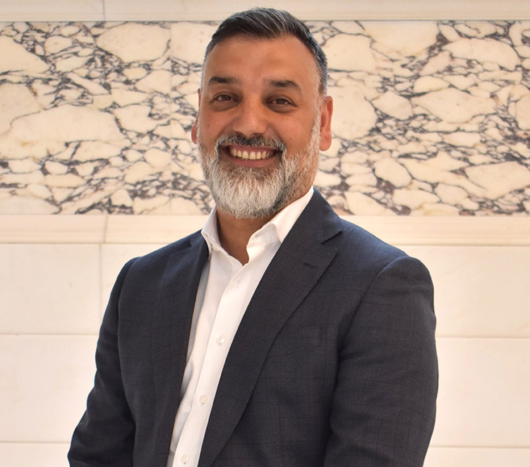
Camden Management
Team (CMT)
Chief Executive
Jon Rowney
Executive Director
Corporate Services
Kathryn Myers
Executive Director Adults and Health
Jess McGregor
Executive Director Children and Learning
Tim Aldridge
Executive Director
Homes and Communities
Dan Hawthorn
Executive Director Investment Place and Opportunity
David Burns
Borough Solicitor
Andrew Maughan
Director of Health and Wellbeing
Kirsten Watters
Director People and Inclusion
Joanna Brown
Director of Strategy, Design and Insight
Osian Jones
Director of Communities and Housing Support
Hanad Mohamed

Slide 2
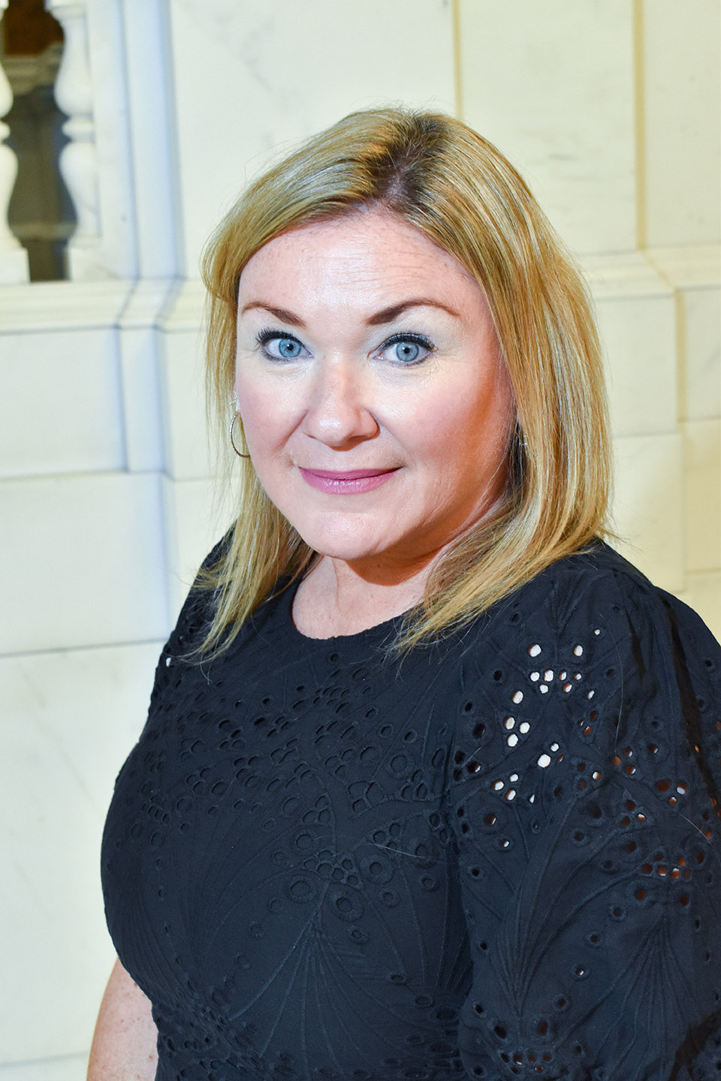
Corporate Services
Kathryn Myers, Executive Director
Director of People and Inclusion
Jo Brown (reporting to Jess McGregor Deputy Chief Executive)
Director of Strategy, Design and Insight
Osian Jones
Director of Finance [Section 151 Officer]
Daniel Omisore
Chief Experience and Information Officer
Tariq Khan
Borough Solicitor Andrew Maughan
Director of Participation, Partnerships and Communications
Caroline Kennedy (interim)
People Relationship Leads
People Operations Lead
Head of Community Partnerships
Head of Strategic Communications
Head of Media and External Relations
Head of Member Support
Head of
Chief Executive Office
Joint Head of
Cabinet Office
Heads of Strategy
Head of Corporate Strategy
Head of Service
and Policy Design
Head of Strategic Delivery and Operations
Head of Insights Learning and Impact
Head of Income Management and Transactional Services
Head of Strategic Finance and Business Partnering
Heads of Finance
Head of Treasury and Financial Services
Chief Accountant
Head of Internal Audit, Investigations and Risk
Head of Customer and Registration Services
Head of Digital Product
Chief Data Officer
Head of Engineering
Head of DDS Operations
Head of Technology
Mayor’s Office
Head of Legal Services and Deputy Borough Solicitor
Head of Business Support
Democratic Services Manager
Electoral Services Manager
Employee Experience Leads
Head of The Way We Work Transformation
Head of Council Tax, Business Rates and Benefits

Slide 3
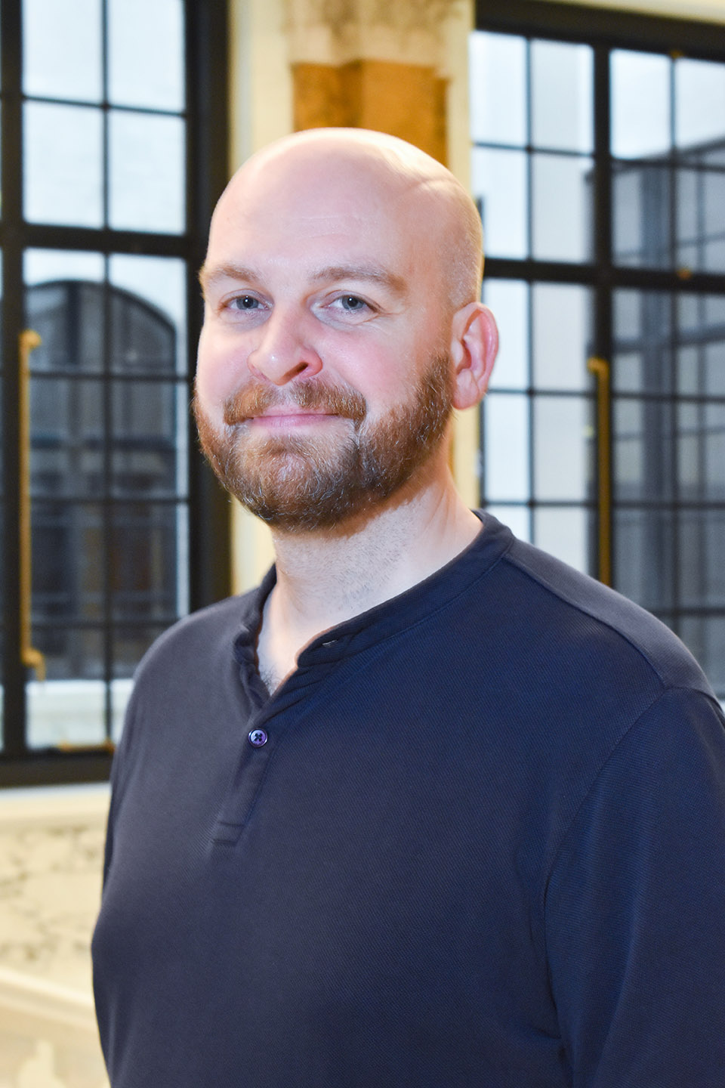
Investment, Place and Opportunity
David Burns, Executive Director
Director of Economy, Regeneration and Investment
Matthew Dibben (July 2026)
Head of Inclusive Economy
Head of Culture
Head of Procurement and Social Value
Chief Planning Officer
Director of Development and Corporate Property
Matthew Rumble (June 2026)
Head of Leisure
Head of Libraries
Head of Community Safety and Enforcement
Environmental Health Manager
Public Protection and Licensing Manager
Head of CIP Programme Office
Head of CIP Development
Director of Recreation and Public Safety
Oliver Jones
Director of Environment and Sustainability
Richard Bradbury
Head of Environment Services
Head of Climate, Air Quality and Energy
Head of Parking Operations
Chief Engineer
Head of Transport Strategy and Projects
Head of Camden Accessible
Transport Solutions
Head of Property
Head of CIP Technical Design
Acting Head of CIP Development
Head of Facilities Management
Head of Camden Living Development
Head of Corporate Resilience
Coronial Services and Business Development
Chief Investment Officer Community Wealth Fund
Head of Euston Regeneration

Slide 4
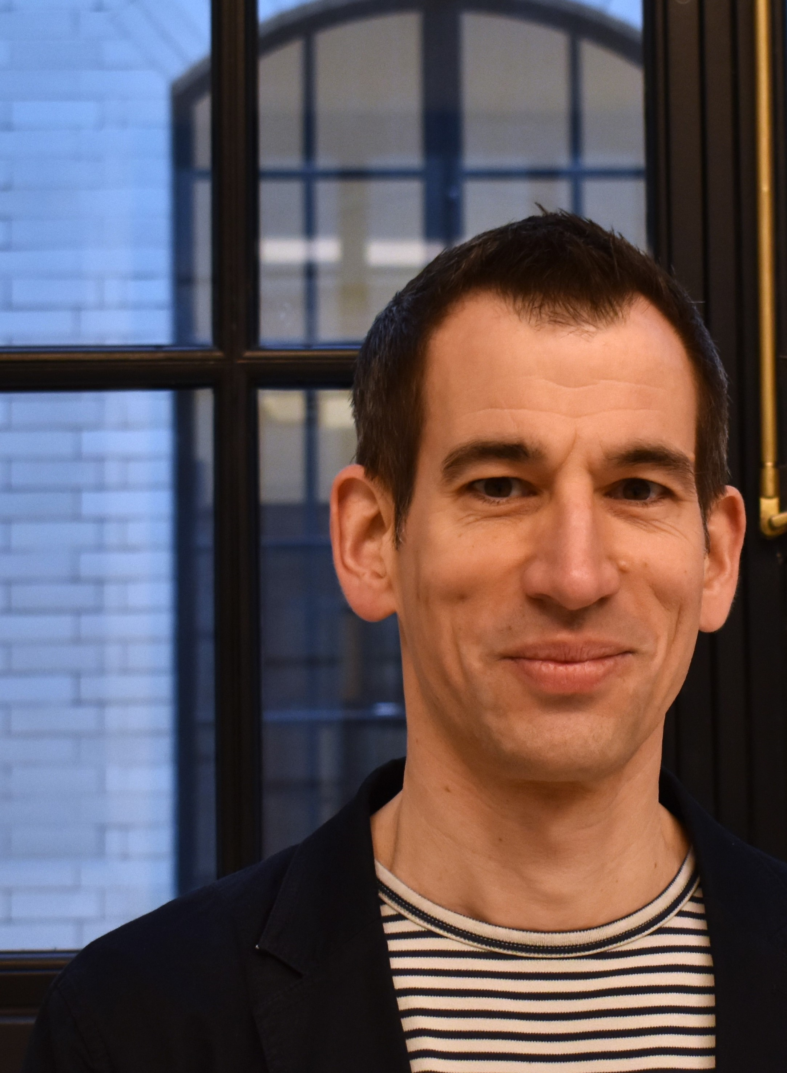
Homes and Communities
Dan Hawthorn, Executive Director
Director of Property Management
Gavin Haynes
Head of Repairs and Operations
Chief Asset Management Officer
Head of Housing and Property Engagement and Customer
Service
Head of Resident and Building Safety
Director of Housing
Glendine Shepherd
Director of Communities and Housing Support
Hanad Mohamed
Head of Equalities and Social Purpose
Strategic Lead Refugee Communities
Head of Debt and Financial Resilience
Head of Housing Solutions
Head of Housing Allocations and Temporary Accommodation
Head of Neighbourhoods (Housing)
Head of Leaseholder Services and Housing Income
Housing Programme Manager
Head of Private Sector and Licensing
Project Director Chalcots

Slide 5
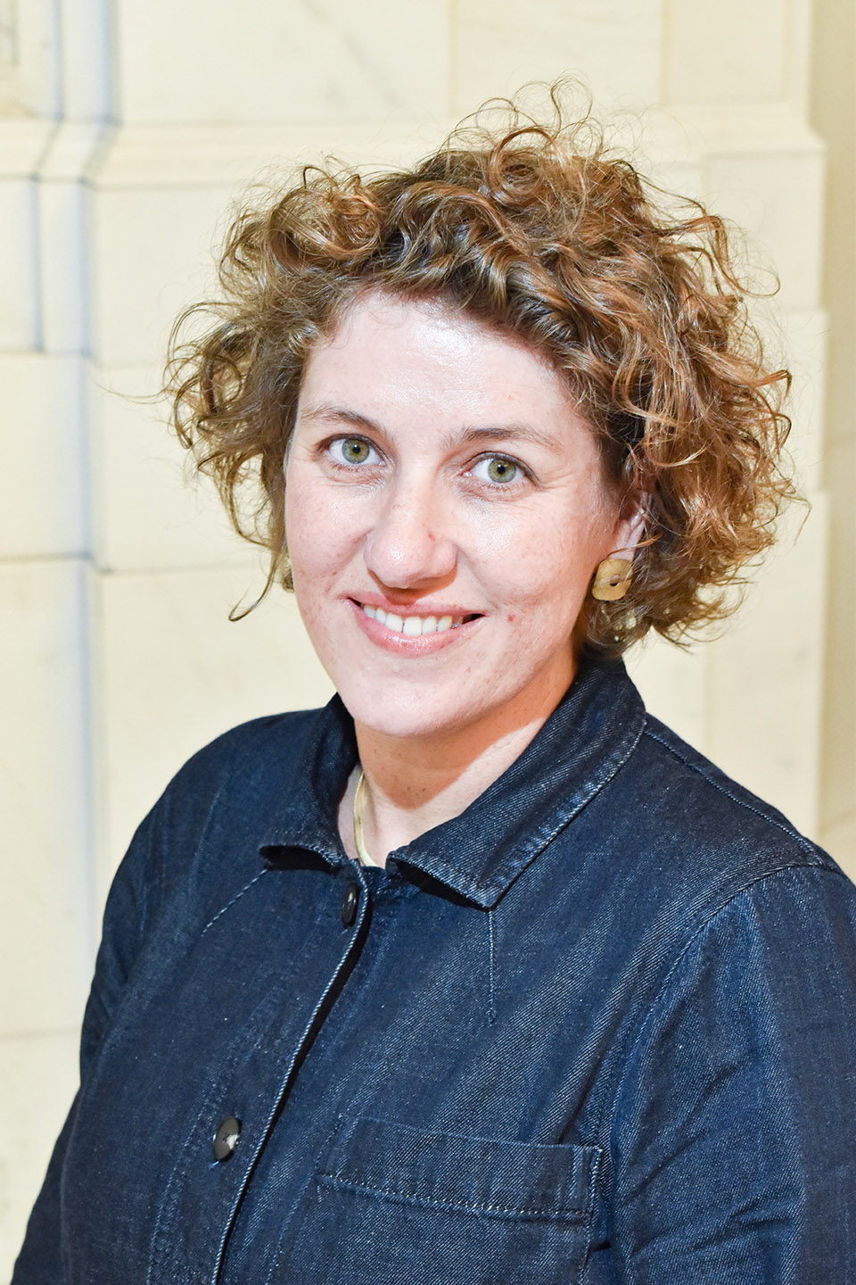
Adults and Health
Jess McGregor, Executive Director (statutory DASS)
Director of ASC Strategy and Commissioning and Deputy DASS
Chris Lehmann
Statutory Director of Public Health and
Director of Health and Wellbeing
Kirsten Watters
Director of ASC Operations and Deputy DASS
Michelle Head
Service Manager, Approved Mental Health Service
Head of Integrated Learning Disabilities and Mental Health
Head of Integrated Neighbourhood Teams
Head of ASC Insight, Quality and Financial Services
Principal Social Worker
Head of Mental Health Transformation
Safeguarding Adults Board Strategic Manager
Head of Adults Commissioning
Head of Learning Disability, Autism and Mental Health Commissioning
Head of Adult Social Care Innovation
Head of Provider Services
Deputy Director of
Public Health
Chief Innovation Officer – Raise Camden
Public Health Consultant
Head of Children and Young People’s Health Improvement
Consultant in Public Health for Children and Young Adults
Head of Drugs, Alcohol and Sexual Health
Partnership Director North London Councils
London ADASS Programme Director
Head of Children’s Commissioning and Health Partnerships
North London NHS Foundation Trust
Public Health Consultant
Deputy Director of Health and Wellbeing
Head of Population Intelligence and Statistical Methods

Slide 6
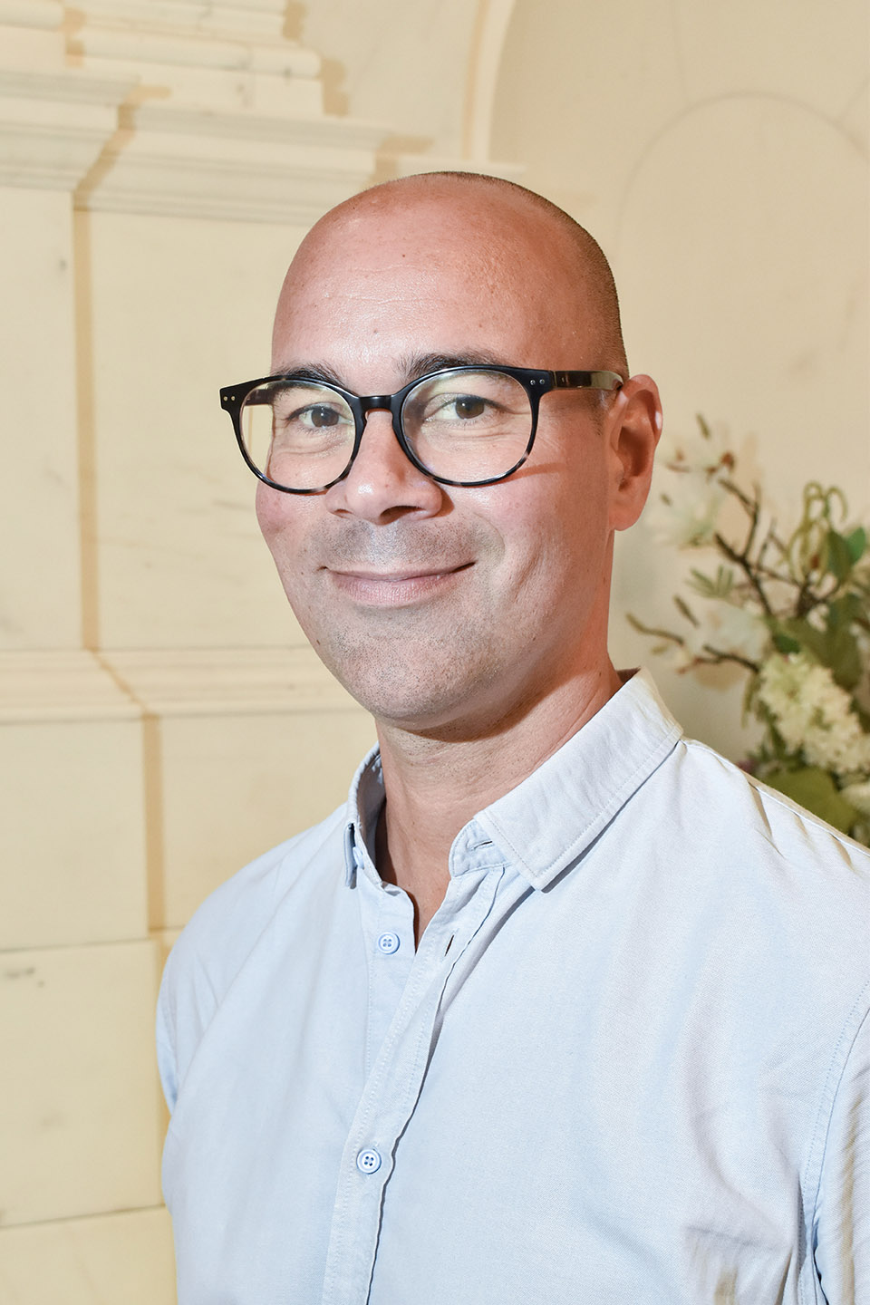
Children and Learning
Tim Aldridge, Executive Director (statutory DCS)
Director of Education Commissioning and Inclusion
Vikram Hansrani
Director of Relational Practice
Jessica Eneberi (interim)
Director of Children’s Prevention, Safeguarding and Family Help
Nana Bonsu (interim)
Head of Children and Young People Disability Service
Head of Children in Need
Head of Integrated Youth Services
Head of Early Years and Family Hubs
Head of Corporate Parenting
Head of Virtual School
Head of SEND and Inclusion
Head of Education Operations
Head of Adult Community Learning
Head of Education Transformation
Head of Children and Learning Transformation
Quality Assurance
Chief Executive
Officer
Director of Finance
and Operations
Director of Strategy, Policy and Governance
Director of STEAM & Partnerships
Senior Advisor Safeguarding and Inclusion
Director of
Learning and Impact
Head of Violence Against Women and Girls
Systemic Workforce Service Lead
Camden Learning

