Slide 1
CAMDEN COMMUNITY SAFETY PARTNERSHIP PLAN
2024 – 2027

Slide 2
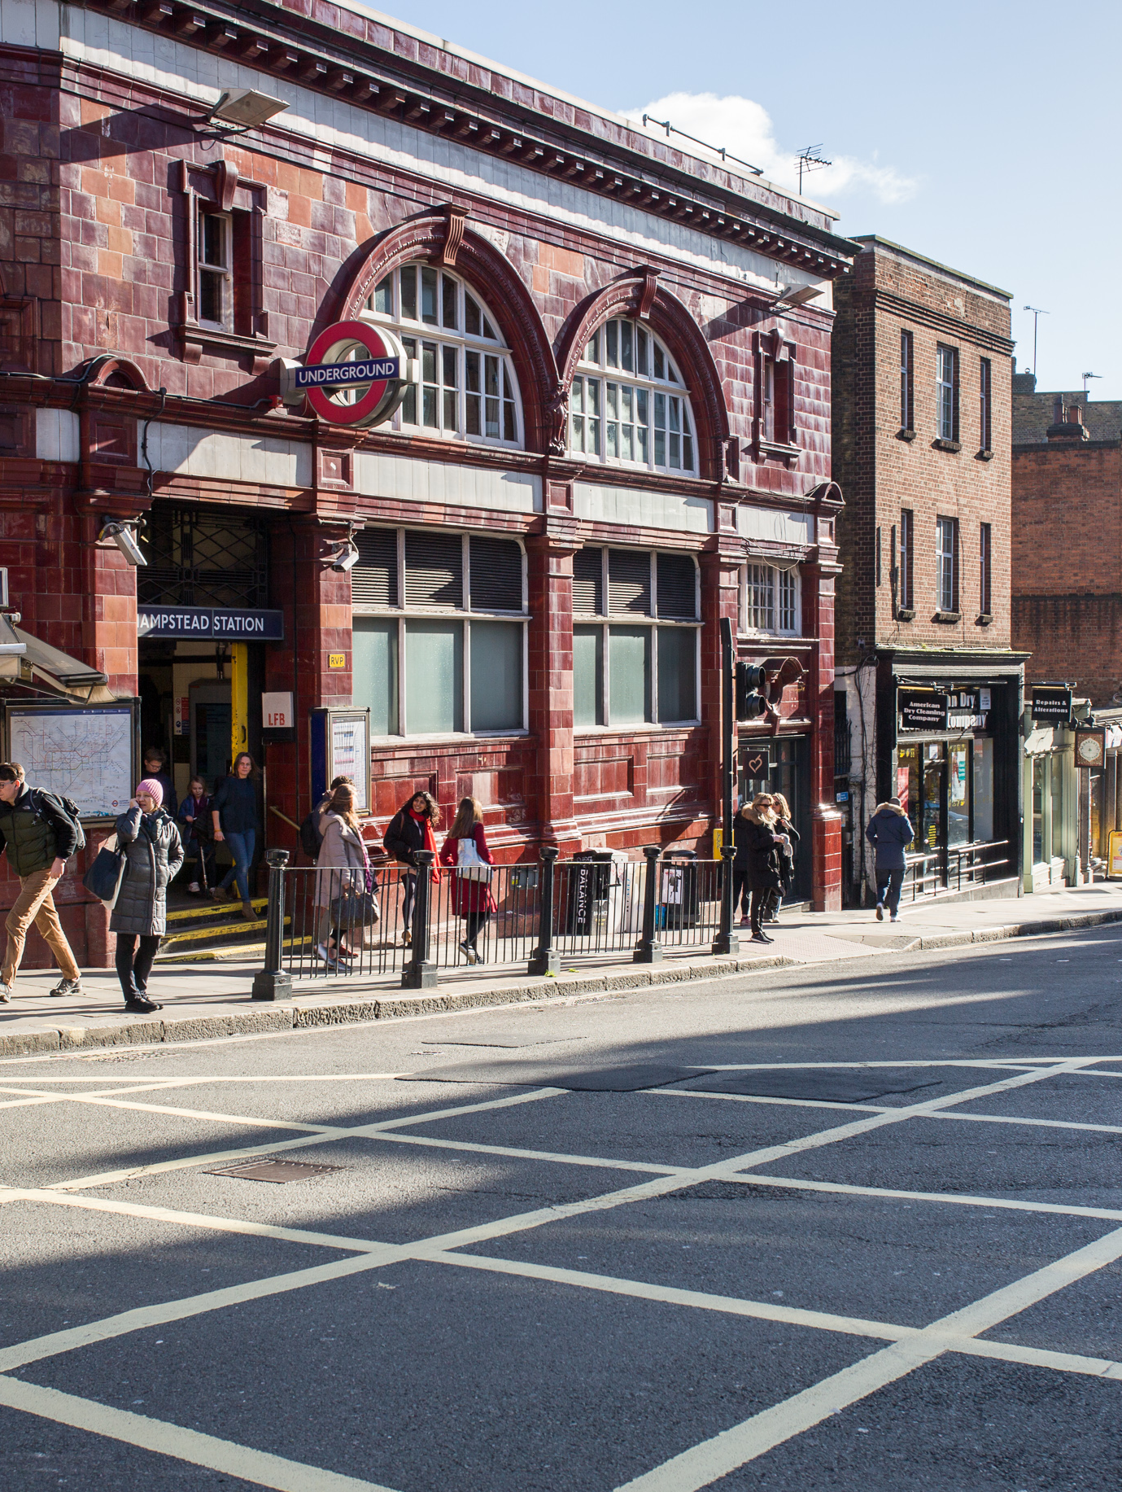
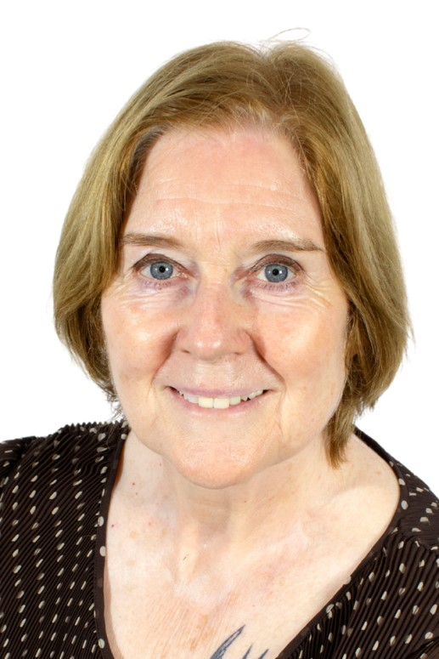
Foreword
I am pleased to introduce the Camden Community Safety Partnership Plan for 2024 to 2027, which sets out the priorities of the Camden Community Safety Partnership Board. The plan takes a resident-centred approach, focussing on the community safety issues of most concern in Camden, ensuring that local voices are heard and responded to effectively.
Since its inception, the Partnership has worked diligently to reduce crime and antisocial behaviour to make Camden a safer place to live, work and visit. However, the nature of crime and antisocial behaviour, and its impact on our communities, are constantly evolving. As a Partnership we must also evolve in our response, by continuing to learn and develop new and innovative ways to tackle some of our most difficult problems.
We are committed to taking a preventative approach by intervening early to reduce the harm caused to our communities. Within this plan, we will continue to work on reducing crime and antisocial behaviour, tackling serious violence and addressing substance misuse, setting out how we can address the complex and challenging issues that impact our local communities. There is an increased focus on women’s safety in the public realm, recognising the need to challenge misogynistic attitudes and to make public spaces safer.
We also remain committed to tackling hate crime in all its forms and will continue to ensure Camden is a place that stands against intolerance and extremism.
This plan describes how we can work together to make Camden a better borough, where everyone can lead safe, healthy and fulfilling lives. It is important we are all working towards the same goals, providing a safe environment for residents, businesses, and visitors. Recognising the complexities involved in keeping communities safe, the Community Safety Partnership will adopt a collaborative approach drawing on the collective efforts of different agencies.
The priorities and objectives outlined in this plan are informed by a comprehensive assessment of crime and disorder issues across the borough and reflect the views of the community. We hope this document helps you understand the work of the Community Safety Partnership and how we will achieve the aims set out through our priorities.
Councillor Pat Callaghan

Slide 3
Contents
Introduction
4
Context – Camden in Profile
5
Strategic Assessment 2023-2024
6
Resident Consultation
8
Community Safety Partnership Priorities 2024-2027
9
Priority 1: Drug Related Activity
10
Priority 2: Serious Violence
11
Priority 3: Women’s Safety in the Public Realm
12
Priority 4: No Place for Hate
13
Priority 5: Antisocial Behaviour
14
Partnership Working
15
Information and Advice
16

Slide 4
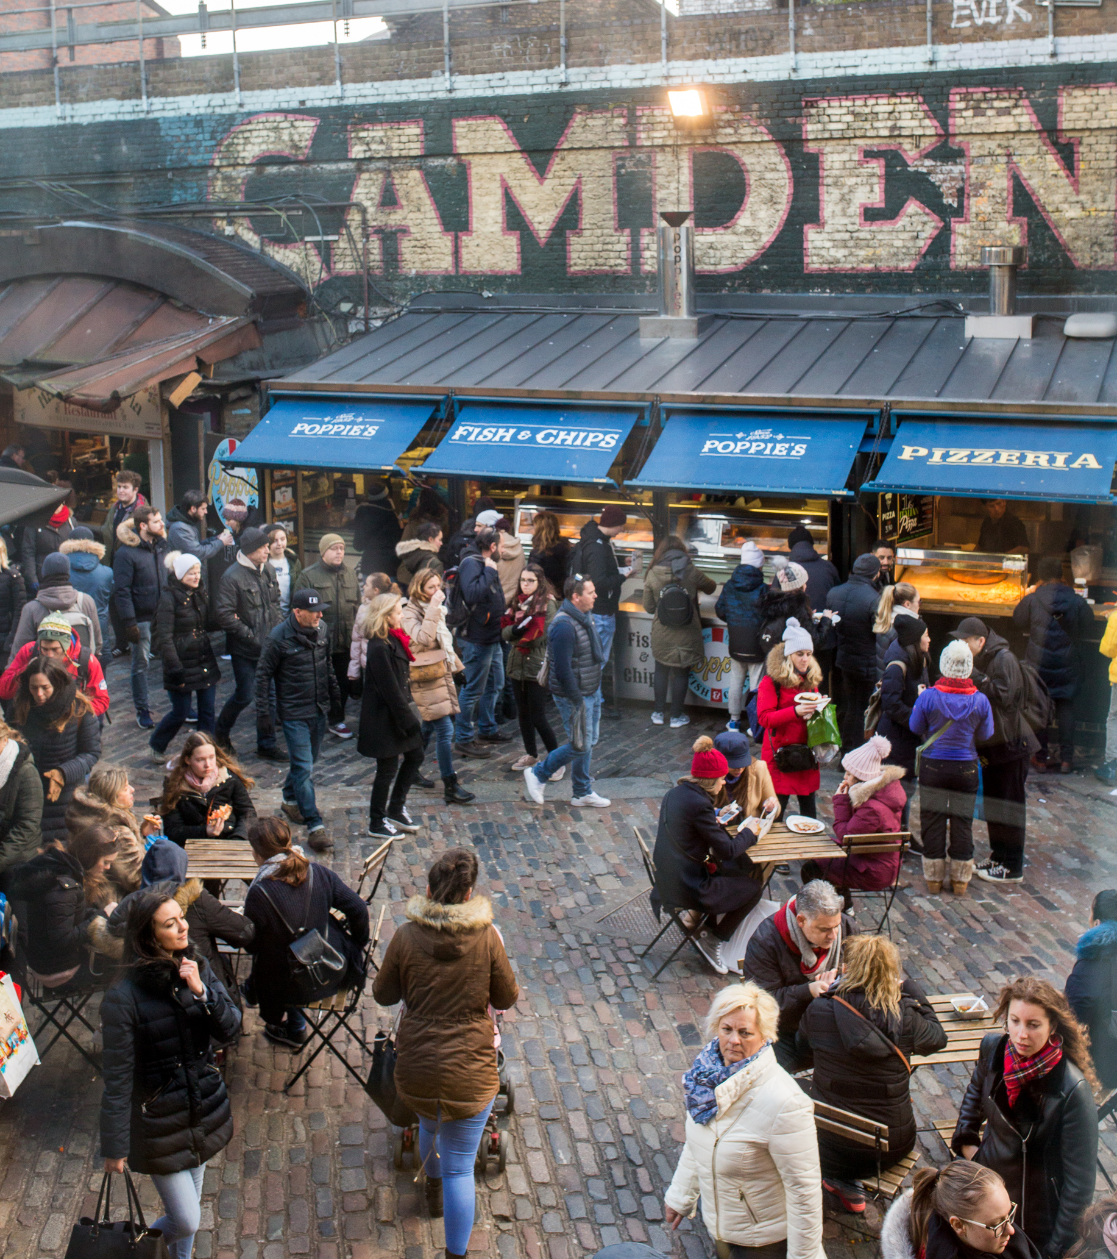
Introduction
Community Safety Partnerships are a requirement of the Crime and Disorder Act 1998. The partnership is made up of representatives from the police, local authorities, fire and rescue authorities, health services, and probation services (known as the ‘responsible authorities’).
The responsible authorities work together to reduce crime and disorder in their communities and to help people feel safer. They work out how to deal with local issues including antisocial behaviour, substance misuse and violence. They assess local crime priorities and consult with partners and the local community about how to address them.
The Crime and Disorder Act 1998 also introduced the principal aim of the youth justice system, which is to prevent offending and re-offending of young people under the age of 18.
The Camden Community Safety Partnership aims to:
Create a safer borough for people to live, work, and visit;
Work in partnership to deliver local priorities that address crime and disorder;
Deliver local, regional, and national priorities.
Achieving these objectives contributes to the wider aims of the We Make Camden strategy and its overriding vision of creating safe, strong and open communities where everyone can contribute.
Community Safety Partnerships are also responsible for conducting an annual review, known as a Strategic Assessment, focussing on crime, antisocial behaviour and substance misuse. The findings from this assessment inform the objectives outlined in the Camden Community Safety Partnership Plan 2024-2027.

Slide 5










Context – Camden in Profile
The estimated population of Camden is 218,000 with 92,758 households. 9.5 per cent of households are overcrowded.
Average age in Camden is 37.2 years. 43 per cent of residents are aged under 30, 66 per cent are aged under 45 and 17 per cent are aged under-18.
51 per cent of Camden residents think they are in very good health.
The total number of reported criminal offences in 2022/3 was 36,649 with Theft, Violence Against the Person and Vehicle Offences most common.
Average life expectancy is 87.7 for women and 83.1 for men.
The average annual earnings for full time working residents in Camden is 44,973.
Camden’s population is ethnically diverse with 40.5 per cent attributed to Black, Asian or other minority ethnic groups.
71 per cent of Camden residents are employed. 4 per cent are unemployed.
Camden is home to 11 higher education institutions and has the 3rd largest student population in London.
15 per cent of the population have a disability or long-term condition that limits their day-to-day activities.

Slide 6



Strategic Assessment 2023-2024
Antisocial Behaviour
No Place for Hate
Women’s Safety in the Public Realm
The Community Safety Team received 2276 reports of antisocial behaviour in 2023.
8% of reports were youth-related, a decrease from the previous year. 82% of reports were adult related, a significant increase from previous year.
Drug use is still the most reported type of antisocial behaviour and accounts for a third of all incidents.
Hate crime offences fell by 7% in 2022 and increased by 20% in 2023.
Fluctuations in rates correspond to national and international events.
The most frequently applied hate crime flags were racism, homophobia and antisemitism which mirrors the overall trend in London.
Resident feedback indicates that more than 70% of women feel unsafe at night.
A Women’s Safety Public Realm Action Plan has been created to address VAWG focussing on offending behaviour, the night-time economy, and public space management
In 2022/23, 1470 referrals were made to Camden Safety Net, the borough’s front-line domestic abuse service.

Slide 7



Strategic Assessment 2023-2024
Drug Related Activity
Serious Violence
Overall Crime
In 2023 there were 1227 drug offences, a decrease of 11% compared to the previous year.*
Addresses of drug-related concern: achieved 11 closure orders; successfully resolved 68 cases; permanently relocated 15 vulnerable people.
Camden allocated a grant of £2.7 million to support the achievement of outcomes outlined in the National Drug Strategy, including increasing numbers in treatment for drug and alcohol misuse.
There is a correlation between violent crime and the night-time economy, with Saturday being the weekly peak.
Robbery rates continue to be high in Camden, placing it within the top 5 boroughs in London.
The Gangs Resettlement Panel and Multi-Agency Child Exploitation (MACE) panel continue to play crucial roles in safeguarding individuals and communities.
Crime levels in Camden have risen by 1.8%, slightly exceeding pre-pandemic levels, in line with the broader trend across London which has seen a 2.2% increase.
During 2023, Camden and Westminster saw the largest year on year increase in crime levels of any boroughs across London, driven by increased footfall and large night-time economies.
Violent Crime, Burglary and Theft all saw significant year on year increases with Robbery seeing the largest increase in Camden in percentage terms (28.3%).
*N.B. decrease in drug offences may not be indicative of the levels of drug use.

Slide 8


Resident Consultation
Consultation with residents told us what they thought would be best to address in the new local plan:
Improve street lighting and signage
Quick and easy ways to report ASB
More CCTV in the streets
Tougher drug policies
Better action from council – prioritising victims of ASB more
Quick, appropriate and compassionate response for victims
More action to improve women’s safety
More visible police presence and security patrols
A safety hub that is open at weekends
More immediate and faster consequences for those who commit ASB
Clear up waste and litter to discourage antisocial activities
More reach out and prevention for those in situations that might lead them to commit crimes

Slide 9





Community Safety Partnership Priorities 2024 - 2027
This plan sets out the five priorities for Camden Community Safety Partnership (CSP). They align with Camden’s broader strategic outcomes:
Safe, strong and open communities where everyone can contribute;
Everyone is safe at home and safe in our communities;
Camden should be green, clean, vibrant and accessible.
The priorities are shared by all members of the CSP. By addressing issues that directly affect communities, we aim to build trust in local police and safety partners. This, in turn, helps make Camden a safer place for everyone.
The CSP priorities are also aligned broadly with the Metropolitan Police Service priorities as set out within the Mayor’s Police and Crime Plan. These are:
Reducing and preventing violence;
Increasing trust and confidence;
Better supporting victims;
Protecting people from exploitation and harm.
Working in partnership to address these issues, the CSP will also ensure it monitors and responds to other specific crime types that present an ongoing problem in the borough.
Priority 1:
Drug related activity
Priority 2:
Serious Violence
Priority 3:
Antisocial Behaviour
Priority 4:
Women’s Safety
Priority 5:
No Place for Hate

Slide 10
Priority One: Drug Related Activity
To reduce the harm caused to young people and adults by drug misuse and take effective action against those who exploit others in the furtherance of drug markets in the borough
Vision
Reduce drug use and related harm
Reduce drug related crime
Disrupt drug supply chains
Improve access to and engagement with substance misuse services
Objectives
Increase education and awareness of drugs, their harms and support services.
Develop diversionary pathways for arrested youth, prioritising support for vulnerable groups.
Increase access to harm reduction interventions e.g. naloxone.
Provide high-quality substance misuse treatment and recovery services.
Increase crime reporting: regular communication with residents and improved reporting mechanisms.
Reclaim and maintain public spaces affected by drugs.
Use a range of interventions and enforcement powers to tackle drug-related crime and protect communities.
Identify and target priority locations through multi-agency intelligence sharing.
Implement measures against premises that condone or facilitate drug dealing and use.
Target drug supply enablers, including illicit firearms money laundering.
Strengthen County Lines Programme to dismantle the violent & exploitative distribution model.
Enhance treatment accessibility and effectiveness through a 'No Wrong Door' approach, flexible appointments and enhanced outreach.
Improve continuity of care for individuals with substance misuse needs.
Ensure recovery support includes access to education, training, employment, benefit maximisation, social prescribing and signposting to community resources.
Strategy
Outcomes
Reduction in drug-related crime
Organised criminal groups and high harm offenders are brought to justice.
Communities have an improved awareness of drugs and their harms.
Communities are equipped with the knowledge to report concerns and access services available.
Increased numbers accessing and successfully completing substance misuse treatment services.
Recreational drug users are aware of the violence, harm and crime that their drug use perpetuates and supports.
Notes:
Documents:
10-year drugs strategy ‘From Harm to Hope’
National Combating Drugs Outcomes Framework
Commissioning Priorities - Camden Health and Wellbeing Department
Camden Drugs Action Plan / action tracker

Slide 11
Priority Two: Serious Violence
To reduce the harm caused by serious violence and exploitation
Vision
Improve analysis and enforcement
Prevention and education
Improve victim support
Enhance community engagement
Objectives
Conduct comprehensive data analysis for a public health approach to violence reduction, focusing on impact across demographics.
Establish a multi-agency response to address individuals at risk of violence or exploitation through enforcement, prevention and diversion.
Increase understanding of disproportionality in the impact of violence, intervention access and community outcomes.
Collaborate with parents/carers and schools to provide universal and targeted interventions.
Develop a programme of actions to remove weapons and educate about the consequences of purchasing online.
Ensure educational environments promote resilience and anti-violence measures, with accessible channels for addressing concerns.
Streamline assessment and referral processes, ensuring prompt access to specialists for at-risk youth.
Provide comprehensive support packages for victims of youth violence and exploitation, for all victims of domestic abuse and for vulnerable adults who experience violence and exploitation.
Ensure hospitals share safeguarding information with local partnerships to facilitate rapid support.
Increase community engagement and participation through collaborative violence reduction programmes.
Involve communities in Stop & Search procedures to increase trust and understanding.
Build capacity and trust in hyper-local communities experiencing high levels of violence to support effective incident response and partnership building.
Strategy
Increased understanding of violence patterns, drivers, and vulnerable areas enabling the development of effective local action plans.
Community engagement and participation in violence reduction indicatives.
Those affected feel supported and are safeguarded.
Violence is reduced.
Outcomes
Notes:
Documents:
Violence and Vulnerability Reduction Action Plans (VRU)
Camden - Serious Violence Strategic Needs Assessment (Jan 24)
Camden Serious Violence Duty – Interim Strategy 20234/24

Slide 12
Priority Three: Women’s Safety in the Public Realm
To improve women’s safety in public spaces and take effective action to address gender-related crime
Vision
Tackling offending behaviour
Enabling a safer evening and night-time economy
Making public spaces safer
Objectives
Strategy
Target offending behaviour in priority areas through a high-profile, intelligence driven enforcement operation.
Deliver a range of women’s safety initiatives including the Safety Hub, Safety Bus, ‘Ask for Angela’ scheme and comms campaign.
Understand the experience of women living, working and visiting Camden to inform operational and strategic activity.
Establish a framework for women's night safety through the adoption of the London Mayor's Women's Night Safety Charter.
Prioritise women's safety in licensing policy and work in partnership with licensed premises to improve safety conditions.
Regular engagement with women to ensure experiences and concerns within the night-time economy are addressed.
Consideration for women's safety and security integrated into the design of public spaces, ensuring that urban environments are welcoming, accessible and safe.
Intelligence-led approach to identify priority locations and develop design-out crime processes.
Engagement with stakeholders to foster a collective commitment to women’s safety.
Increased level of enforcement action taken to address gender-related crime and anti-social behaviour.
Reduced incidents of violence against women and girls in public places.
Women and girls feel safer in public spaces.
Increased confidence of women to report safety concerns to police and partner agencies.
Clear message across the borough that harassment and misogyny is not acceptable.
Outcomes
Notes:
Documents:
Camden Women’s Safety Action Plan in Public Realm

Slide 13
Priority Four: No Place for Hate
To reduce hate and intolerance, creating a safe, strong and inclusive community
Vision
Increase hate crime awareness
Improve support for victims
Build community resilience
Prevent extremism and radicalisation
Objectives
Develop a better understanding of hate crime through research, data analysis and community engagement.
Increase the reporting of hate crime through awareness campaigns, training and third-party services.
Promote positive outcomes arising from hate crime investigations to encourage reporting.
Provide a range of hate crime reporting mechanisms.
Improve communication of investigative processes and case updates to victims.
Training for front-line staff enabling them to confidently support victims.
Dip-sampling of hate crime and hate incidents to inform practice and improve partner response
Promote inclusive and tolerant communities by supporting community engagement events and cohesion programmes.
Work with schools and community groups to deliver prejudice, hate and extremism awareness training and resources.
Enable and support communities to counter hateful speech and actions.
Develop understanding of spaces, online and offline, where harmful narratives may spread and take steps to reduce permissive environments.
Work with partners to ensure activity to reduce radicalisation is specifically targeted at identified risk.
Safeguard individuals at risk of radicalisation through the Prevent process.
Strategy
Outcomes
Improved confidence to report hate crime.
Increased support for victims of hate crime.
Increased awareness of hate crime within communities.
Increased cohesion and resilience within local communities.
Increased community confidence to recognise, report and challenge hate and radicalisation.
Community organisations play an active role in keeping Camden safe from hate and radicalisation.
Notes:
Camden Hate Crime Strategy
Camden Prevent Strategy

Slide 14
To decrease antisocial behaviour and reduce the impact on individuals and communities
Vision
Prevent antisocial behaviour
Refine policy and improve procedure
Enable effective enforcement
Improve support for communities
Objectives
Provide young people with positive opportunities to divert from antisocial behaviour.
Improve physical infrastructure to design out crime.
Implement preventative measures through collaboration with police, health, and voluntary sectors.
Staff receive trauma-informed and MECC training to support individuals in accessing the right care.
Collate intelligence on ASB related issues and develop a comprehensive profile for Camden to inform operational activity.
Refine ASB case management, data processes and reporting systems to promote consistency and drive service improvement.
Develop clear escalation process for complex cases.
Utilise a range of interventions, including enforcement, to reduce harm and impact on communities and individuals.
Trained workforce able to effectively implement interventions to reduce levels of street drinking, drug use, environmental damage and associated behaviour.
Robust monitoring systems designed to track the use of interventions and their effectiveness.
Intelligence-led initiatives to effectively address crime and ASB on disproportionately affected locations.
Implement Mental Health Protocol to foster greater understanding and consideration of link between ASB and mental health.
Use multi-agency risk assessment meetings more effectively to develop a unified partnership approach for managing high-risk cases.
Strategy
Priority Five: Antisocial Behaviour
Outcomes
People feel safer on our estates and in public places.
Reduced levels of street drinking, drug use and associated behaviour.
Reduced levels of environmental damage.
Comprehensive ASB profile for Camden to inform operational delivery.
Residents report ASB through correct channels.
Notes:
Documents:
ASB Policy (draft)
ASB Procedure (draft)
ASB Taskforce Review

Slide 15
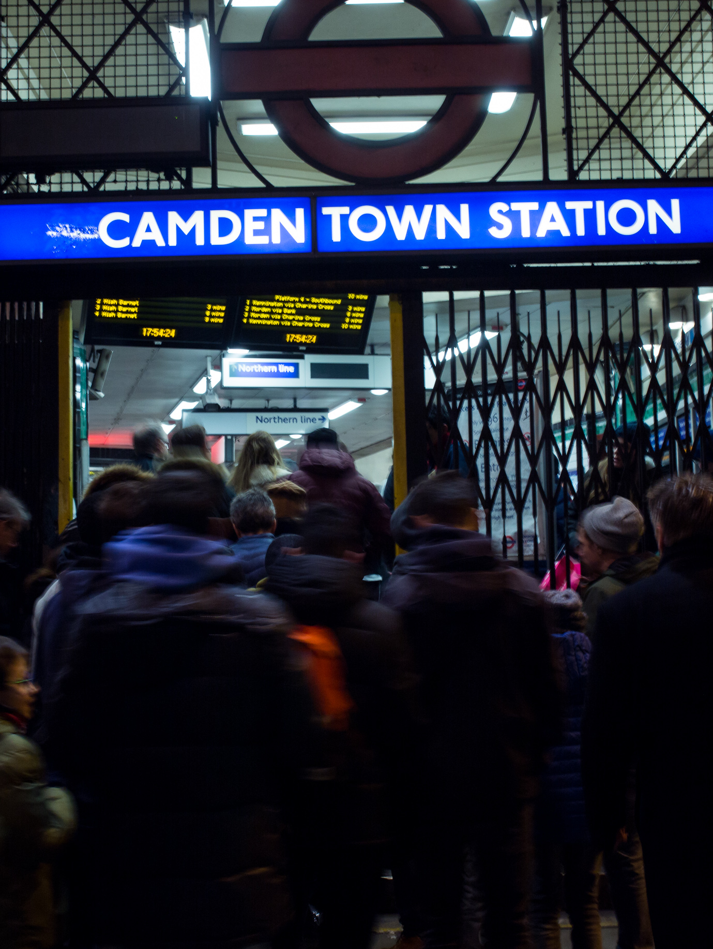
Partnership Working
The Community Safety Partnership (CSP) is responsible for delivering the priorities outlined in this plan. There are, however, a range of strategic boards and delivery groups that support the CSP to meet its priorities and statutory duties. This requires partners to work together to share skills, knowledge and resources to effectively reduce crime and antisocial behaviour in Camden.
Camden’s CSP is one of several statutory partnerships within the borough including the Health and Wellbeing Board, the Safeguarding Children Partnership and the Safeguarding Adults Partnership Board. Issues impacting on community safety cut across these boards, including safeguarding and underlying social and health challenges that impact on the level of crime, such as substance misuse and mental health. The CSP will work with these and other partnerships to ensure a cohesive approach.
Safer Neighbourhood Boards (SNBs) operate in every London borough, bringing police and communities together to decide local policing and crime priorities, solve problems collaboratively, and make sure that the public are involved in a wide range of community safety decisions. The SNB operates alongside the CSP so that local community is considered and can contribute when making strategic decisions.
Structure of the CSP
The CSP has an executive board which meets bimonthly to set the strategic direction and monitor progress of the partnership’s priorities.
There are several strategic sub-groups which coordinate and deliver activity on specific areas including:
VAWG Board
Women’s Safety Working Group
Combatting Drugs Partnership
ASB Review Working Group
Youth Safety Taskforce
Robbery Focus Group
Prevent Steering Group
Tension Monitoring Group
Crime and ASB issues are also discussed at the following community forums:
Safer Neighbourhood Board
Independent Advisory Group
Ward Panels
The Community Safety Partnership Board and its subgroups meet regularly to review delivery of this strategy and related delivery plans, monitor and scrutinise progress and ensure coordination between partners.

Slide 16
Information and Advice
Police
Phone: 999 (in an emergency or when a crime is happening)
Phone: 101 (non-emergency and to report ASB)
Web: www.met.police.uk/report (Report ASB and crime online to the police - for drug dealing select antisocial behaviour)
VAWG Services
Web: Camden Safety Net
Email: camdensafetynet@camden.gov.uk
Drug and Alcohol Services
Change Grow Live:
Web: Adult Drug and Alcohol Services - Camden | Change Grow Live
Phone: 020 7485 2722
Email: camden.referrals@cgl.org.uk
Via Care – Drug and Alcohol Support for people who sleep outside (InRoads):
Web: InRoads Camden
Phone: 0300 303 4545
Email: inroads.camden@viaorg.uk
Online referral: InRoads Camden Referral
Routes off the Streets:
Web: Camden Routes off The Streets
Phone: 0207 846 3535 (or freephone 0808 800 0005)
Email: streetsafe@cgl.org.uk
Youth Services
Web: Youth clubs and support services - Camden Council
Email: info.youth@camden.gov.uk
Antisocial behaviour
Web: Camden Council website and reporting online
Phone: 0207 97444 (follow the prompts until asked to hold, then go to the submenu and choose option 6 for Community Safety)
Hate Crime and Prevent
Web: Camden Council Hate Crime and Camden Council Prevent
Web: Children’s Safeguarding Partnership Radicalisation and Extremism
Phone: 999 (in an emergency); 101 (non-emergency)
Stop Hate UK: 0800 138 1625 (24 hours/day) or text 07717 989 025
Report hate online: www.report-it.org.uk
Prevent Safeguarding Referral:
For children email LBCMashadmin@camden.gov.uk
For adults email asc.mash.safeguarding@camden.gov.uk
Victim Support
Phone: 0808 168 9291 or 0808 168 9111 (out of hours)
Web: Victim Support
Health and Wellbeing
• Web: Your health and wellbeing - Camden Council (useful contacts and links to NHS services, physical health, mental health, sexual health, addiction, children, young people and families)

