Slide 1

Camden Housing Taskforce
Housing Delivery Taskforce 2:
How Should Camden Build?
November 2025

Slide 2
Contents
Introduction
State of play - market review
Viability assessment of different tenures
Delivery routes for Camden
Discussion

Slide 3

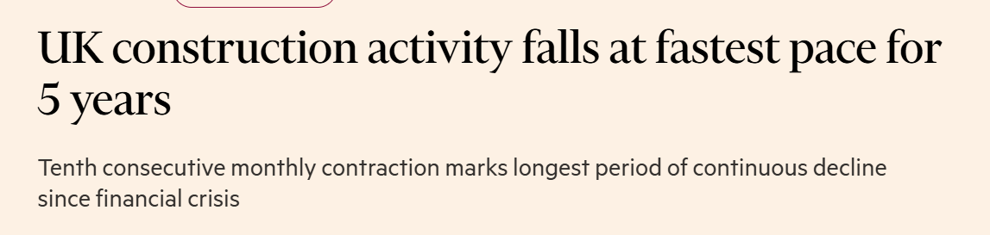
Current state of play
Introduction | State of play | Tenure viability | Delivery routes | Discussion
Reasons behind the lower delivery rates:
  Increase in the cost of capital;
  Inflation of build costs;
  Design and viability requirements of the London Plan;
  Retrofit requirements reducing capacity for Registered Providers and Local Authorities;
  Increased reliance on private cross subsidy of affordable housing delivery s106 over the years means a delivery slow down is a slow down in affordable housing delivery as well.
Source: Molior
Notes:
The predictability of the UK economy remains fairly difficult to follow as we continue to observe the growing disconnect between MPC easing policies and the underlying rate market.
There are lots of things I can attempt to cover but I will focus on the difference between the blue line and the green line of about 100bps – where the difference, or “steepening” close to a 10yr high.
Typically, when interest rates are higher you have flatter curves and when interest rates are lower you have steeper curves. This makes intuitive sense as when current interest rates are on the floor - such as in 2016 when they were 0.5% - the future path for interest rates has to be higher which leads to a steeper curve.
The opposite is true when current interest rates are high - if rates are going higher then surely we should have a flatter curve? But that is not the case; we are getting a steeper curve as long end interest is going in the opposite direction to short term interest rates.
Like most things in life, the answer is not entirely simple. There are a number of different factors;
- The market expects lower interest rates for the next 18 months;
- Higher long end interest rates from the Unites States Treasury market are having an effect;
- Investors want a higher premium for holding long term bonds;
- Investors want a higher premium for holding gilts;
- The UK’s large fiscal deficit will mean large supply of gilts for years to come;
- Demand is shifting away from domestic to international buyers.
In part these reasons for the current shape for the UK gilt curve are intertwined. The state of the public finances means extra borrowing of around 300 billion a year in gilts. These are large numbers and so investors do not need to worry about the scarcity value of gilts, there will be plenty to go around. Indeed, as long end gilt yields rise, this will impact the deficit numbers by making the interest costs worse for the government, requiring more gilts!
So, with that in mind, lets focus on now and Rachel Reeves’s previous fiscal headroom (roughly £10 billion) is likely to be wiped out ahead of the autumn budget, driven by policy developments and the Office for Budget Responsibility’s likely downgrades to near-term growth.
Labour markets and wage inflation are now showing signs of cooling and we expect services inflation—which has broadly tracked 5% in recent months—to soon follow suit. ​These developments, coupled with the prospect of fiscal policy being tightened further in the autumn budget in the form of taxes to address the headroom change, and long-term inflation expectations being well anchored, the BoE should be convinced that that inflationary pressures will subside despite current stickiness.​
Taking all of this into account, we continue to expect the BoE to maintain a quarterly cadence of easing. This would put the bank rate at 3.75% at the end of 2025 and at 3.25% by mid-2026.​ We also expect the BoE to set its next 12-month plan for reducing its gilt holdings in September 2025.​
But the reasons for the fundamental disconnect remains and we therefore would signal rates will remain elevated for the foreseeable future.

Slide 4
Increases in cost of finance – personal, business and public borrowing
Introduction | State of play | Tenure viability | Delivery routes | Discussion
Movements in UK Gilts and Bank of England Base Rate (2019 to present)
Gilt rates (%)
US election
Nov 24
Liz Truss budget
Sep 22
US Tariff
Apr 25
Lockdown
Mar 20
War in Ukraine
Feb 22
Source: Newbridge / Bloomberg 03 November 2025
Notes:
The predictability of the UK economy remains fairly difficult to follow as we continue to observe the growing disconnect between MPC easing policies and the underlying rate market.
There are lots of things I can attempt to cover but I will focus on the difference between the blue line and the green line of about 100bps – where the difference, or “steepening” close to a 10yr high.
Typically, when interest rates are higher you have flatter curves and when interest rates are lower you have steeper curves. This makes intuitive sense as when current interest rates are on the floor - such as in 2016 when they were 0.5% - the future path for interest rates has to be higher which leads to a steeper curve.
The opposite is true when current interest rates are high - if rates are going higher then surely we should have a flatter curve? But that is not the case; we are getting a steeper curve as long end interest is going in the opposite direction to short term interest rates.
Like most things in life, the answer is not entirely simple. There are a number of different factors;
- The market expects lower interest rates for the next 18 months;
- Higher long end interest rates from the Unites States Treasury market are having an effect;
- Investors want a higher premium for holding long term bonds;
- Investors want a higher premium for holding gilts;
- The UK’s large fiscal deficit will mean large supply of gilts for years to come;
- Demand is shifting away from domestic to international buyers.
In part these reasons for the current shape for the UK gilt curve are intertwined. The state of the public finances means extra borrowing of around 300 billion a year in gilts. These are large numbers and so investors do not need to worry about the scarcity value of gilts, there will be plenty to go around. Indeed, as long end gilt yields rise, this will impact the deficit numbers by making the interest costs worse for the government, requiring more gilts!
So, with that in mind, lets focus on now and Rachel Reeves’s previous fiscal headroom (roughly £10 billion) is likely to be wiped out ahead of the autumn budget, driven by policy developments and the Office for Budget Responsibility’s likely downgrades to near-term growth.
Labour markets and wage inflation are now showing signs of cooling and we expect services inflation—which has broadly tracked 5% in recent months—to soon follow suit. ​These developments, coupled with the prospect of fiscal policy being tightened further in the autumn budget in the form of taxes to address the headroom change, and long-term inflation expectations being well anchored, the BoE should be convinced that that inflationary pressures will subside despite current stickiness.​
Taking all of this into account, we continue to expect the BoE to maintain a quarterly cadence of easing. This would put the bank rate at 3.75% at the end of 2025 and at 3.25% by mid-2026.​ We also expect the BoE to set its next 12-month plan for reducing its gilt holdings in September 2025.​
But the reasons for the fundamental disconnect remains and we therefore would signal rates will remain elevated for the foreseeable future.

Slide 5
Market Commentary
Introduction | How we got here | Tenure viability | Delivery routes | Discussion
Camden HPI vs BCIS All in TPI
Cumulative House Price Inflation: 5.3%
Cumulative Build Cost Inflation: 22%
Hypothetical Development
(single flat)
Values: £512k
Build Costs: £305k
GIA:NIA: 80% → 74%
Net: £207k
Less available for:
Cross subsidy
Planning levies
Fees
Finance and Profit
Values: £525k
Build Costs: £250k
Net: £275k
Values: £553k
Build Costs: £305k
Net: £248k
Inflation
Fire Safety
Notes:
Fire safety legislation has created a requirement for a second means of escape within high rise buildings (above 18m in height). This means that floorspace that was previously used for the provision of sellable floor space now must be used for a second staircase, which is not revenue generating and therefore is a cost to a developer.

Slide 6
Reduction in delivery by Registered Providers
Introduction | State of play | Tenure viability | Delivery routes | Discussion
Retrofit and Balance Sheet Constraint Impact
Camden has spikier profile than London as there are fewer schemes to blend the data.
Camden’s planning department highlighted that application volumes have reduced, those have approval are seeking to renegotiate their affordable housing commitments on viability grounds. Greatest volume is for Purpose Built Student Accommodation (PSBA) and Co-Living.
Anecdotal evidence of fewer traditional Registered Providers being active in the Borough – impact on take up for S106 schemes.

Slide 7
GLA Emergency Measures
Introduction | State of play | Tenure viability | Delivery routes | Discussion
Public policy under consultation
The GLA are consulting on the following supply side measures.
These measures are not yet formally introduced. They are time limited, which if developers breach may lead to profit sharing.
Essentially, Late-Stage Reviews are removed conditionally, which may still have a limiting impact on funding delivery.
In addition, repeated calls for demand side assistance (such as Help to Buy) are present within the market.
GLA Emergency Measures
Affordable housing fast track tariff requirement lowered to 20%. Grant available on 50% of these homes.
Mayoral call in for applications of 50 homes or more (where the LPA are minded to refuse).
LCIL will be chargeable at 50% of prevailing rate (where it is a brownfield site with at least 20% affordable housing being provided).
Dual aspect and cycle design restrictions withdrawn.
City Hall developer established with £322m.
Available until the sooner of March 2028 or new London Plan publication

Slide 8
Tenure Viability Assessment

Slide 9


Principle of cross subsidy
Introduction | How we got here | Tenure viability | Delivery routes | Discussion
How the private sector delivers affordable housing
There is limited direct state provision of affordable housing. Camden’s CIP is an outlier in the scale and success of its self-delivery programme
Nationally, nearly 50% of all affordable housing is delivered through s106 agreements without grant – delivery by developers through cross subsidy. RPs have been key top this model by buying homes from developers
Build costs for affordable and private are similar, but values vary significantly across the tenures
Below illustrates the impact of cross-subsidy assuming a homes that costs £450k to build, with an open market value of £904k.
Surplus (pre fees) = £454k
Build for £450k
Sell for £904k
Private home
Affordable Housing Provision @50% affordable
Affordable home
Surplus (pre fees) = £161k
Build for £900k
Sell for £904k
Sell for £157k

Slide 10
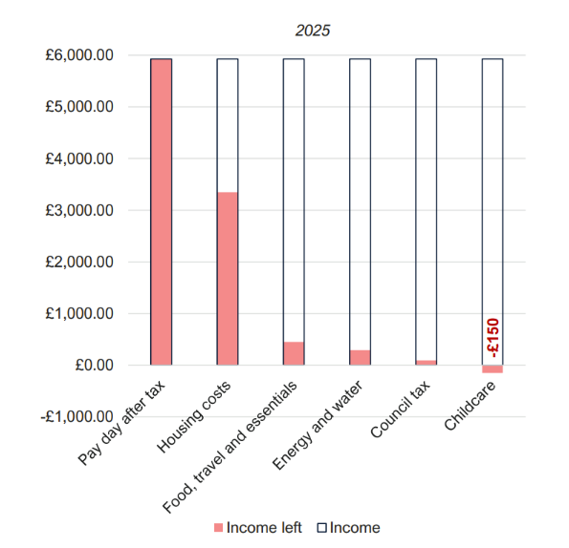
Evidence of need of delivering affordable housing
Introduction | How we got here | Tenure viability | Delivery routes | Discussion
Requirement for affordable housing
The below details the monthly deficit a couple in Camden experience, despite both receiving median incomes
PRS rental increases continue to pressure household incomes and disposable income, especially for families. London rents have increased £550 pcm since Jan 2019.
Increasing the intermediate rent income cap (£67k household income) may incentivise families to stay in Camden, who are currently living in unaffordable private market housing.
Monthly cash position: £89k pa couple with primary school child
Source: PRD
Source: ONS

Slide 11
Evidence of impact of the intermediate income cap
Introduction | How we got here | Tenure viability | Delivery routes | Discussion
Is the GLA £67k household income too restrictive?
Below are examples of public sector workers (key workers) and young people, and their eligibility for intermediate rent.
Most are eligible for intermediate rent. However, two teachers, and two nurses four years into their career are not and must rely on the private market.
Housing costs are deemed unaffordable if above 40% of monthly income.
Only two nurses four years qualified can live in acceptably affordable private homes. Albeit a one bed is highly likely to be impractical for most.
This details a gap in provision of affordable housing. Key workers beyond their starting salaries are ineligible for intermediate rent, and most private housing is unaffordable on mid-career key worker salaries.
Person / Group | Household Income | Qualify for intermediate Rent | % of household income spent on private 1 bed | % of household income spent on a private two bed
One Nurse | £31k | Yes | 94% | >100%
One Teacher | £34k | Yes | 87% | >100%
Young People | £34k | Yes | 87% | >100%
Two Nurses | £62k | Yes | 47% | 60%
Two Teachers | £68k | No | 43% | 55%
Two Nurses (4yrs qualified) | £84k | No | 36% | 46%
£67k Cap

Slide 12
Capital value vs income payable
Introduction | How we got here | Tenure viability | Delivery routes | Discussion
Correlation between capital values and resident income required
Value difference in Camden private house prices and a social rent unit is £747k (before grant).
Grant can be used to support the principle of cross subsidy and ensure there is enough return for a developer.
An intermediate tenure charging £2.6k pcm could increase family retention in Camden, with a surplus of £500 pcm for the couple and child.

Slide 13
Viability of schemes at intermediate tenures
Introduction | How we got here | Tenure viability | Delivery routes | Discussion
Scheme with 35% affordable housing (60% Social Rent / 40% Intermediate)
Item | Intermediate Rent | 50% fam housing
Number of Properties | 200 | 188
Affordable Homes | 70 | 66
Residual Land Value £ | £4.9m | £4.7m
Existing Use Value £ | £12.5m | £12.5m
Gap to Benchmark Land Value £ | £7.60m | £7.80m
AFH % to get to positive RLV | 17.5% | 17.5%
Grant Required to get to 35% AFH | £10.50m | £10.67m
Fewer homes due to introduction of larger family homes
Based on feedback from the previous session, we have tested an intermediate rental tenure.
Only 17.5% affordable housing is achievable once land is included in both scenarios, however due to having larger units in the family housing, there are fewer overall units.
There is a policy decision to make between quantum of affordable versus larger family homes.
Note, GLA AHG now regards more family units on estate regeneration as additionality.

Slide 14
Co-Living Viability and tradeoffs
Introduction | How we got here | Tenure viability | Delivery routes | Discussion
Comparing a co-living scheme to a conventional open market sale scheme
Item | Co-Living Scheme | Conventional OMS Scheme
Number of Properties / bedrooms | 480 bedrooms | 200 apartments
% Private | 100% | 65%
% AFH (60% SR / 40% Int.) | 0% | 35%
Affordable Homes | 0 | 70
Residual Land Value £ | £20.95m | £4.9m
Existing Use Value £ | £12.5m | £12.5m
Gap to Existing Use Value £ | +£8.45m | £7.60m
AFH % to get to positive RLV | n/a | 17.5%
Max cash in lieu payment | £6.95m | n/a
Co-living has the potential to remove at least 480 people from HMO sharing market, meaning increased availability of houses for families.
In the right parts of Camden, residents looking for short term leases have access to a dedicated service with amenities on site.
However, Co-Living has no family housing or affordable housing within the scheme. Using the payment in lieu, our model provided for c. 12 affordable homes (assuming no land cost).
PBSA works on a similar basis and Camden LPA has also secured on site provision for affordable general needs homes.

Slide 15
Delivery Options

Slide 16
Camden Delivery Vehicles
Introduction | How we got here | Tenure viability | Delivery routes | Discussion
Camden has experience across a range of delivery vehicles.
Camden’s direct delivery programme through the Community Investment Partnership (“CIP”) is more advanced and developed than most other developers in London.
Camden also has Camden Living Ltd, plus the Registered Providers.
In addition to self delivery through CIP, the following schemes are in partnership contracts with developers:
Camden has developed a wealth of experience through CIP; however, financial capacity within the Housing Revenue Account (HRA) drives a need to explore alternative delivery vehicles
Development | Delivery Vehicle
Greenwood Centre | Development Agreement with Kier
Charlie Ratchford Court | Development Agreement with Vistry
Bacton 2 | Development Agreement with Mount Anvil
Camley Street | Development Agreement with Ballymore / Lateral

Slide 17
Camden Delivery Vehicles
Introduction | How we got here | Tenure viability | Delivery routes | Discussion
Direct Delivery
Partnership
Pros:
  Control over design and delivery.
  Flexibility to respond to change, switch tenures and move residents between schemes to minimise decant.
  Retain financial surplus or elect to translate this into more affordable.
  Integration of new stock into existing platform.
  Highly skilled development workforce in house.
  Good reputation for delivering community centric development.
Cons:
  Requires upfront capital expenditure from the HRA.
  Higher level of risk in event of market downturn.
  Higher build costs on account of design spec and location.
Pros:
  Less risk - transferred to the private sector.
  Potential for land receipts and profit sharing (at low risk).
  Private developer expertise and supply chains should deliver a more cost-efficient scheme.
  Ability to negotiate levers of control within the contract e.g. planning change and tenure controls.
  Ability to scale pipeline upwards using same amount of capital, therefore delivering more homes.
Cons:
  Delivery of the homes is beholden to private sector return requirements.
  Loss of control over design and programme.
  Risk of loss of skills developed for self delivery.
  Changes are slow to implement through contracts.

Slide 18
What do we collectively mean by ‘Joint Ventures’?
Introduction | How we got here | Tenure viability | Delivery routes | Discussion
Development Agreement(s) - contractual
Investment Partnership on large scheme
Investment partnerships across Borough
Investment partnerships with Camden Living
Project Corporate Joint Venture(s)
Project
Joint ventures come in many shapes and sizes – select the vehicle(s) that work for Camden
Portfolio

Slide 19



Discussion
Introduction | How we got here | Tenure viability | Delivery routes | Discussion
How should Camden Build, and how can Camden make a difference?
What can Camden change
What can Camden influence directly
Actions for areas without direct control or influence
Approach to direct delivery and partnerships on Camden owned land
Allocation of HRA funding capacity
Internal planning process and policies, including design and levels of family housing – incl. priority between volume and family homes
Expand role of Camden Living to take on a more active role acquiring S106 in the Borough
Whether to support Co-Living, in either a blanket or targeted in certain areas
Apply for affordable housing grant under the new programme – including housing for Key Worker Rent
Engage with For Profit RPs in the sector to encourage investment in Camden
Encourage investment models for LHA housing including partnerships with PRs selling void properties. Benefit to TA
Encourage positive engagement with LPA through best practice and procurement routes
Develop lessons learned from CIP self delivery and partnership projects
Lobby for more flexible funding products that work for London through the National Housing Bank and GLA
Be a pilot Borough for these products to demonstrate what can work and attract a first call on funding
Lobby Central Government for taxation and incentive programmes (such as lower SDLT for potential downsizers, or ringfencing for delivery of homes).

Slide 20
Disclaimer

