Slide 1
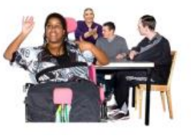
Disability Oversight Panel
Presented by
Councillor Kemi Atolagbe

Slide 2
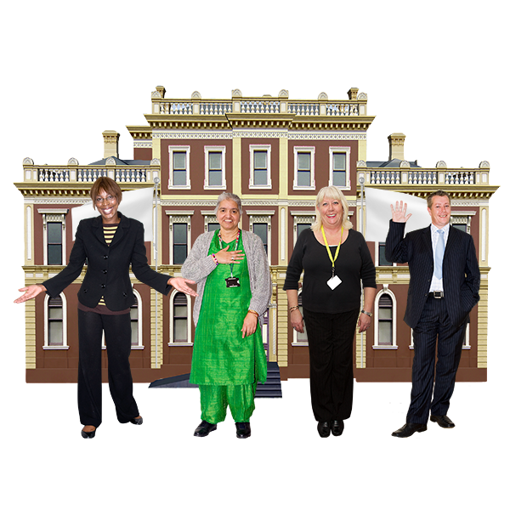
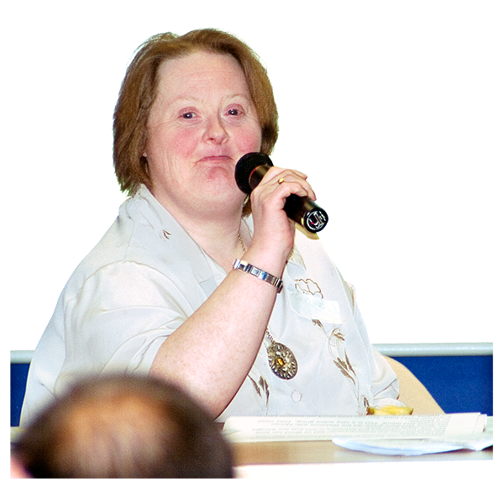
Background
The Disability oversight Panel started 5 years ago
Councillors spoke to leader of the council about their concerns
they felt residents with disabilities did not have a voice and the panel was set up.

Slide 3
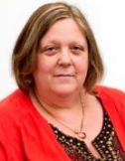
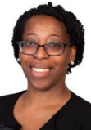
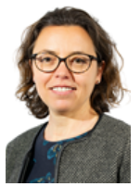
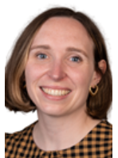
Disability Champions
Cllr Larraine Revah–Chair, Carers and Older People’s Champion
Cllr Kemi Atolagbe–Vice Chair, Learning Disability and Hidden Disability Champion
Cllr Anna Burrage - Physical Disability Champion
Cllr Lorna Greenwood – Mental Health Champion

Slide 4
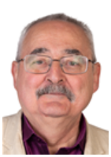
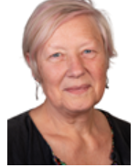
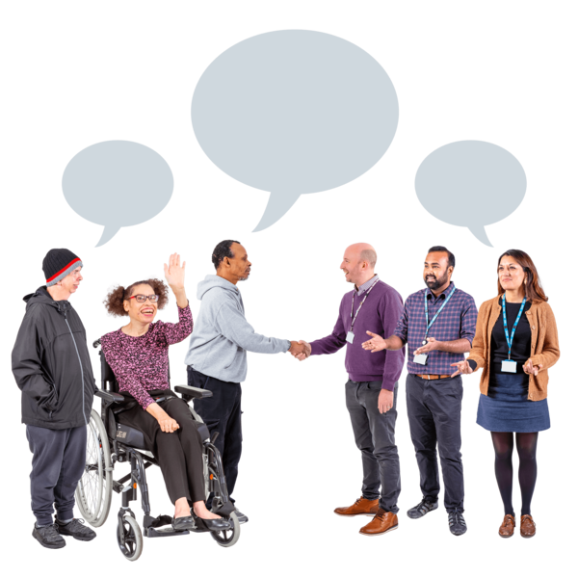
Disability Champions Continued …
Cllr Richard Cotton-Deaf & Hard of Hearing Champion
Cllr Sylvia McNamara–Blind and Visually Impaired Champion
Disability Champions introduce the panel to groups that support each area of disability championed
and talk about what support is available to vulnerable residents

Slide 5
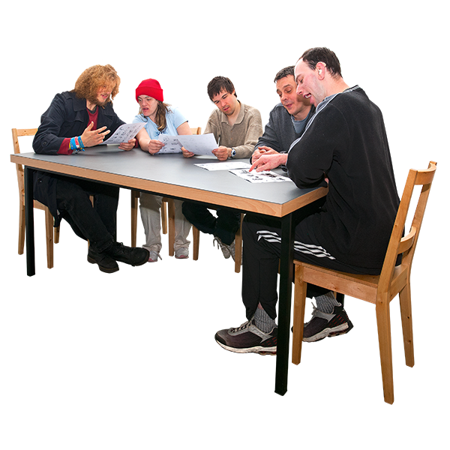
What is the Disability Oversight Panel?
The Disability Oversight Panel focuses on:
Listening to residents with disabilities on policy and strategy issues
Support the things that are most important to residents with disabilities within the work of the Council
Working with other Scrutiny committees to look at the issues important to residents with disabilities in Camden

Slide 6
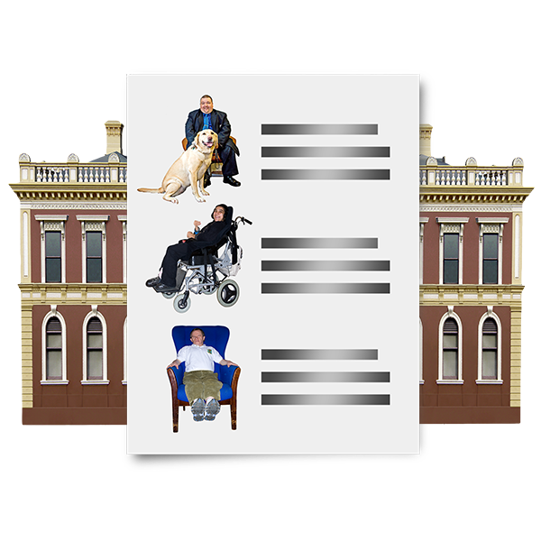
What is the Disability Oversight Panel?
Organising public meetings with key stakeholders in the Council, community groups, other public sector organisations and residents with disabilities to focus on particular issues for discussion
To feedback to the Council regularly, and at least once a year, on the work of the Equalities Champions and the Disability Oversight Panel

Slide 7
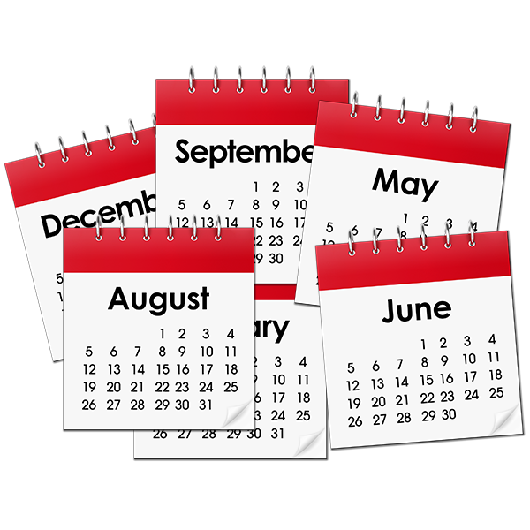
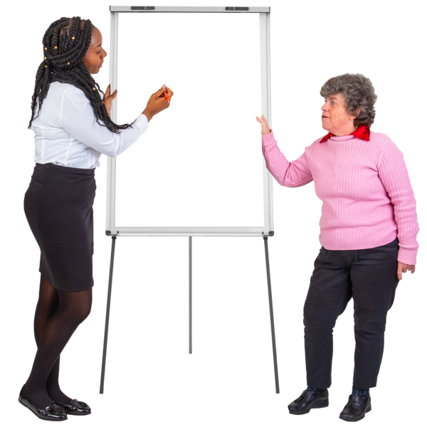
Engagement with the public
The Disability Oversight Panel meet 3 times per year
They also hold public engagement event with several residents, community groups and stakeholders to talk about a key topic which is looked at in greater detail
There is a workshop style discussion that can inform the Committee making recommendations to the Council or to third parties (such as Transport for London).

Slide 8
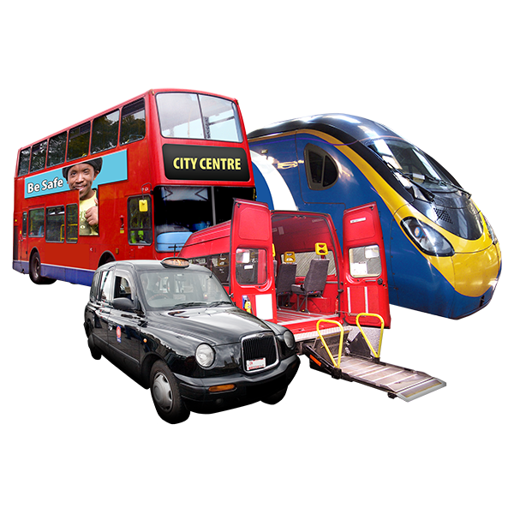
Earlier meetings
Some of the earlier public Committee and panel meetings have focused on:
Accessible transport and the work of Transport for London
We Make Camden and our key community priorities
Looking at the Council Tax Reduction Scheme and how it supports people with disabilities

Slide 9
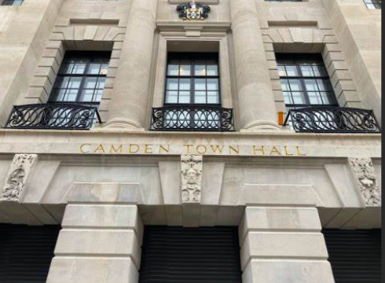
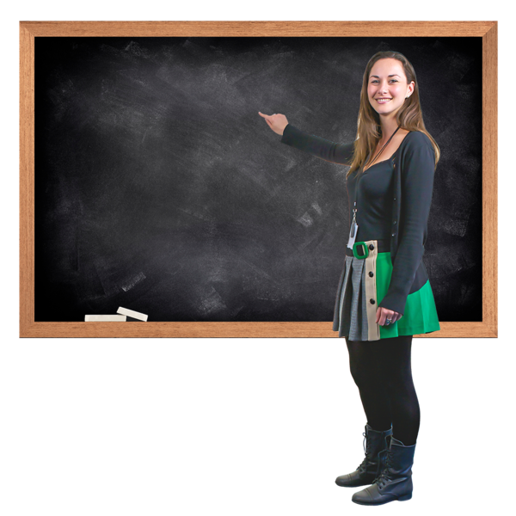
Earlier meetings
Updating Camden Town Hall and Accessible Buildings
How the Council is addressing the impact of race and disability discrimination together as part of Building Equal Foundations
Special Educational Needs and Disabilities Strategy development
Leisure service strategy and procurement

Slide 10
Larraine Revah’s special surgeries
Greenwood Centre
Open to all Camden residents with a disability or their carer.
Every third Tuesday of the month from 1pm to 3pm.
Please book via memberssupport@camden.gov.uk
Henderson Court
Open to all Camden residents over 55.
First Friday of each month, 11am-1pm.
Please book via Henderson Court Centre - 020 7794 6588 or Henderson Court, 102 Fitzjohn's Avenue, London, NW3 6NS

Slide 11
Feedback
We want service users to know about the Disability Oversight Panel
We welcome feedback/suggestions on the theme we should cover during our public engagement event.

