Slide 1
Camden’s Joint Health and Wellbeing Strategy 2020
Latest assessment of the needs of Camden residents

Slide 2
Developing the strategy: three ‘buckets’ of activity
Understanding population needs and assets
Evidence and data-led approach to understanding key HWB issues and priorities
Refresh of the JSNA
Developing a population segmentation methodology to better understand and describe how needs and service/resource use cluster and vary between different population segments/cohorts
Mapping and aligning existing strategies and outcomes across the health and care system
Identify and summarise the outcomes and ambitions articulated in existing system strategies
Assess progress against these
Map common themes and an outcomes logic model
Participation and co-production
Stocktake of existing resident and patient participation and engagement work on health and wellbeing, to distil key themes and insight - i.e what have we heard already
Citizen’s Assembly & Summit
Other stakeholder conversations and engagement events
Formal consultation on the draft strategy

Slide 3
Camden Joint Strategic Needs Assessment 2020: Overview
Camden residents are living longer. Life expectancy at birth has increased in Camden for both males and females and is now significantly higher than London and England.
However, there are still inequalities between the most and least deprived areas in the borough for both life expectancy and healthy life expectancy. Men and women in the most deprived areas of Camden live 18 and 19 fewer years in a healthy state than their counterparts in the least deprived areas, respectively.
Average life expectancy at birth (2017-19)
Deprivation is a key determinant of wellbeing. Overall Camden ranks as the 20th most deprived borough out of 33 London boroughs. Deprivation is concentrated in south/central areas of the borough, namely St Pancras and Somers Town, Haverstock, Gospel Oak and pockets in Kings Cross.

Slide 4




Overview
Key wider determinants that affect the health of Camden’s population:
  Housing: Camden has a lower rate of households in temporary accommodation than London (2017/18), but an estimated 13,979 households in Camden are overcrowded (approximately 11%). The highest in London is Newham at 26% and the lowest is Bromley at 4%.
  Employment: About one in ten people aged 16 to 64 years are claiming an out-of-work benefit in Camden (8%), similar to the the London average (February 2020). 60% of these are claiming benefits on the basis of incapacity (INCAP benefits).
  Among those claiming sickness and disability benefits 58% are due to mental illness. Ethnicity breakdown is only available for Employment Support Allowance claimants, where Black (15%) and Asian (19%) are overrepresented compared to Camden’s general population (7% and 14% respectively). Ethnicity is not recorded for 21% of the population
  Education: A lower proportion of 5 year olds in Camden are reaching a ‘good level of development’ at the end of reception (73%), similar to the London average in (2018/19). A slightly lower proportion of 16-17 year olds in Camden in 2018 were not in education, employment, or training compared to the London average (3.6% compared to 4.8%).
  Violent crime: In 2018/19 the rate of violent offences in Camden was higher than London, but lower than England overall.
Notes:
INCAP benefits include includes Employment Support Allowance (ESA), Incapacity Benefits, Disablement Allowance, and Income Support for those claiming on the basis of incapacity.
Mental illness from the following benefits :Employment Support Allowance (ESA), Incapacity Benefits, Disablement Allowance

Slide 5
Impacts of COVID19 on the wider determinants of health
Housing | Association between overcrowding and multi-generational households and spread of Covid-19 – highlighted overcrowding as a factor which influences health and wellbeing. Greater exposure to determinants of health related to poor quality housing – e.g damp, mould, physical hazards Other potential impacts of time spent at home leading to poorer health – limited space for work, study and play, pressure on relationships, increased abuse, increased exposure to second-hand smoke, impacts on sleep and mental health • Inequalities in good quality and affordable housing – lower socio-economic groups, BAME groups, private renters. Housing market as a result of Covid may compound existing inequalities e.g for people with disabilities and those on benefits in finding affordable and suitable accommodation.
Employment | Claims for Universal Credit have nearly doubled in London between March and June The rise in benefit claims relating to unemployment in London appears to be higher than the UK average Mass unemployment and constrained consumption globally Some sectors e.g. transport and tourism have been particularly badly affected London is vulnerable due to the high numbers of people employed in the hospitality and accommodation sectors
Education | Concerns around educational attainment gap due to school closures Differential home schooling provision, environment and equipment
Crime/Violent crime | Concerns around increase in domestic violence and neglect.
Source: The wider impacts of COVID19 and recovery of population health in London. PHE. ADPH. Mayor of London

Slide 6
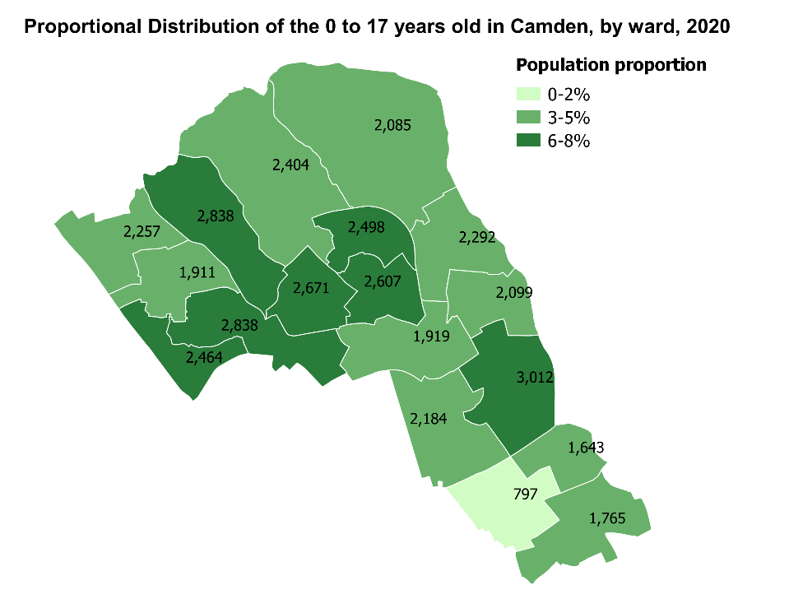
Start well (0-17 years): key messages
Around 40,300 young people aged 0-17 in Camden, fairly evenly split by gender. Young people have the highest ethnic diversity among the borough, with half of the population from Black, Asian, Mixed and other ethnic groups.
Although young people are spread across the borough, more young people live in the most deprived areas compared to the least deprived areas.
In many areas, outcomes for children and young people in Camden are very positive:
  Teenage conceptions - Camden’s teenage conception rate has significantly declined in recent years in line with national and London trends (from 17 per 1,000 girls in 2013 to 12 per 1,000 girl in 2018).
  Looked after children - Bucking the national trend, the rate of looked after children in Camden has decreased since 2014 (from 27% in 2014/15 to 26% in 2018/19).
  Education - The proportion of 5 year olds in Camden reaching a ‘good level of development’ at the end of reception has increased significantly over the past 5 years from 63% in 2014/15 to 73% in 2018/19.
  Youth offending – In 2018, the rate of children in the youth justice system, first time entrants to the youth justice system, and first time offenders have all declined faster in Camden than in London, with Camden now having similar rates to London.

Slide 7




Start well (0-17 years): key messages
Although the vast majority of young people are healthy, there are areas requiring improvement:
Children living in poverty 2016
Mental wellbeing 2018
About 15% of children (under 16s) in Camden live in relative low income families, and although the rate has been increased from 12% in 2014/15 to 15% in 2018/19 it remains lower than both London and England.
Although Camden has a similar estimated prevalence of mental health disorders in young people to London and England, child hospital admissions for mental health conditions in Camden (118 per 100,000) are higher than London and England (73 and 88 per 100,000). Females are more likely to have common mental illness in this age group.
Education and employment 2018
Excess weight 2018/19
A lower proportion of 16-17 year olds in Camden are not in education (3.6%), employment, or training compared to the London (4.8%) and England average (5.5%).
Children aged 10-11 years living in the most deprived areas of Camden are significantly more likely to be overweight or obese compared to those in the most affluent parts. Boys, and children from Asian and Black ethnic groups are more likely to be overweight or obese than girls and children from White ethnic group. Children 10-11 living from King’s Cross, Kilburn, and St Pancras and Somers Town are more likely to be overweight or obese.
Complex needs 2018
Long Term Conditions 2018
There is a high prevalence of young people with health/social needs, i.e. learning disabilities, severe physical disability. Males, young people from Black and Asian ethnic groups, and young people in Cantelowes and Haverstock are more likely to have these needs.
The number of young people diagnosed with a long term condition in Camden is low. Boys are more likely to being diagnosed with a single long term condition than girls, as are young people from Black ethnic groups and young people in Holborn and Covent Garden.
Notes:
Domestic violence
Complex multiple disadvantage – clustering

Slide 8
Impact of COVID19 on Start Well
Maternal, antenatal and early years (0-5) | • Reduced support in pregnancy and for new parents, e.g. parenting classes and breastfeeding support • Change in unplanned pregnancy rates • Reduced take-up of routine immunisations leading to potential future outbreaks • Closure of early years settings removes opportunities for early socialisation and development • Lack of childcare impacts on parental employment and income
School-aged children (5-16) | • Concerns around educational attainment gap due to school closures • Differential home schooling provision, environment and equipment • Changes (reductions?) in physical activity and diet for children, including loss of free school meals and breakfast clubs – child obesity was already high in London and links with deprivation • Family financial circumstances, poor housing and food insecurity impacts on children
Transition to adulthood | • Disruption to education and exams, along with financial constraints, may limit future opportunities • Economic recessions have tended to have a disproportionate impact on young people’s employment • Young adults have been more likely to lose jobs, be furloughed, and work in a sector forced to close than other age groups. They are less likely to be able to work from home. • Scarring impacts of early unemployment and debt on health over the life course
Safeguarding and mental health | • Fewer opportunities to identify and monitor safeguarding concerns, and reduced access to support for children and families • Evidence that child maltreatment and domestic abuse increase during periods of economic recession • Multiple stressors impacting mental health of children and young people, including changes to or lack of routine, increased isolation, uncertain future, stress and anxiety and bereavement
Source: The wider impacts of COVID19 and recovery of population health in London. PHE. ADPH. Mayor of London

Slide 9
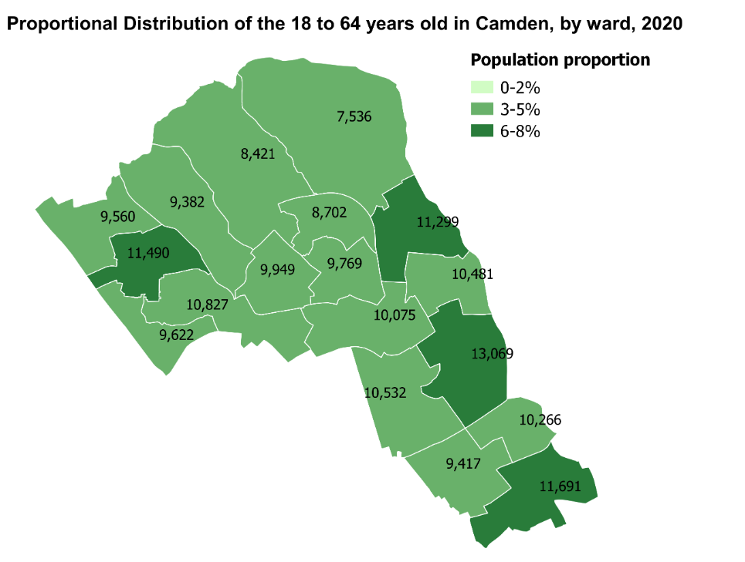
Live well (18-64 years): key messages
The age structure of Camden is, and will continue to be, dominated by a young working age population. Deprivation is a key determinant of poor health and wellbeing outcomes in this age group.
There are around 182,100 people aged 18-64 in Camden.
They are most concentrated in the centre and south of the borough.
They are fairly evenly split by gender, and about two thirds (67%) are from
White ethnic groups (a higher proportion than the younger cohort).
In many areas, outcomes for this working age population in Camden are positive:
  Suicide - since 2006, the suicide rate in Camden has decreased to a level similar to London and England (from 16 per 100,000 population in 2006-08 to 11 per 100,000 population in 2017-19).
  Smoking (year) - the prevalence of smoking has declined since 2014, and smoking-attributable mortality has declined faster in Camden than in London (from 16% in 2014 to 12% in 2019).
  Physical activity – In 2018/19, a lower proportion of adults were physically inactive in Camden (17%) than in London or England (21% and 22% respectively).

Slide 10
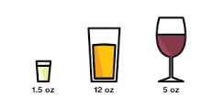
Live well (18-64 years): key messages
Areas of wellbeing that are of particular concern are:
Mental Wellbeing 2018
Long Term Conditions 2015
The proportion of people with depression and/or serious mental illness is higher in Camden than the London average. People who are otherwise healthy with a common mental illness make up the third largest segment in this age group. Continuing the pattern seen in young people, women are more likely to belong to this population segment, as are residents from Mixed and White ethnic groups and residents from the most deprived areas of the borough.
Diagnosis of long term conditions begins to increase in this age group. In Camden, hypertension is the most common long term condition followed by diabetes. Male residents are more likely to belong to the segment of people with a single long term condition, as are residents from Asian, Black and White ethnic groups and residents from the most deprived areas.
Employment 2020
Disabilities and social needs 2018
  About one in ten people aged 16 to 64 years are claiming an out-of-work benefit in Camden (8%), similar than the London average. Higher proportions of claimants are found in Black and Asian groups. About 60% of sickness and disability claims are due to mental illness.
  Camden has seen a 47 increase in Universal Credit Claims before COVID19 (February 2020) to after the first peak. There are currently just over 11,000 people claiming UC.
Residents aged 18-64 with disabilities/social needs remains a substantial cohort. Male residents are more likely to belong to this group, as are residents from Black and White ethnic groups and residents from the most deprived areas of the borough.
Alcohol 2018
Complex health needs 2019
  Camden continues to face challenges related to alcohol. In line with national trends, Camden’s alcohol-related hospital admissions have increased since 2011, and the rate in Camden is higher than both London and England. People who are otherwise healthy but who have one or more behavioural/lifestyle risk factors (including alcohol) makes up the second largest segment of Camden residents aged 18-64. Men are more likely to belong to this group, along with residents from Black, Mixed and White ethnic groups and residents from the most deprived areas of the borough.
In this age group, a segment with complex health needs (individuals with multiple long term conditions or severe frailty) appears for the first time. Men are more likely to have complex needs as are individuals from Asian and Black ethnic groups and residents from the most deprived areas of the borough.
Notes:
Domestic violence
Complex multiple disadvantage – clustering

Slide 11

Age well (65+ years): key messages
In Camden, there are around 32,700 people aged 65+. They are most concentrated in the centre and north of the borough. There are more women (55%) and more than three quarters (80%) are from White ethnic groups.
Women make up a larger proportion of older people, and also tend to be healthier than men in this age group. Not only are women more likely to be healthy, they are also more likely to have only a single long term condition.
Healthy Life Expectancy and Long Term Conditions 2016/18
Disabilities and social needs 2018
Although people in Camden are living longer, residents on average spend the last 20 years of their life in poor health. Mortality rates are highest among those with cancer, cardiovascular disease and respiratory diseases, but mortality for all three causes of death has been declining and is lower in Camden than London and England.
Older people with disabilities/social needs make up the second largest group in this age group. This group includes individuals with dementia, and Camden has the highest prevalence of dementia in London. Older people from White ethnic groups are more likely to belong to this group, as are residents from the most deprived areas of the borough.
Deprivation 2019
Complex health needs 2019
Just under a quarter of people aged 60+ in Camden are facing income deprivation. Although older people are spread across the borough, relatively more older people live in the most deprived areas compared to the least deprived areas.
Older people with complex needs (multiple long term conditions and frailty) make up the biggest group of older people in Camden, in contrast to the younger population and working age population reflecting, increasing frailty in this age group. Older people with complex needs are more likely to be men, from White ethnic groups and residents from the most deprived areas of the borough.
Notes:
Domestic violence
Complex multiple disadvantage – clustering

Slide 12
Impact of COVID19 on Live well and age well
Physical activity | • Activity limited by lockdown, working from home and school closures • Change in levels and type of physical activity • Possible increase in sedentary behaviour • Opportunity presented by policy encouraging and facilitating active travel, e.g. TfL Streetspace
Healthy eating | • Evidence of change in dietary behaviours • Psychological impacts of lockdown impact food choices • Rising food insecurity and use of food banks • Half of children entitled to free school meals did not receive them in April 2020 • Challenges around measuring changes to physical activity and diet, and obesity levels • Opportunity presented by policy drive to reduce obesity due to its links with COVID-19
Smoking | • Mixed evidence of trend in smoking behaviour during lockdown • Insecure economic circumstances associated with increased smoking and smoking inequalities – as is affordability of cigarettes • Disruption to smoking cessation support services, in particular face to face services • Motivation for smokers to quit due to campaigning around links to COVID-19
Alcohol | • Changes in patterns of alcohol use • Concern around potential increases in problematic drinking – one survey found nearly a fifth of daily drinkers in the UK had further increased the amount they drank during lockdown • Potential drivers for increasing alcohol consumption include changing habits, bereavement, isolation, troubled relationships, job insecurit
Substance misuse | • Disruption to support services during lockdown, though unclear on the extent and impact • Reduced access to youth workers, school teachers etc. of concern regarding children vulnerable to being caught up in drug use or gangs • Changes in London drug supply and availability • Reports of increased online gang recruitment and activity
Source: The wider impacts of COVID19 and recovery of population health in London. PHE. ADPH. Mayor of London

Slide 13
Impact of COVID19 on Live well and age well
Changing need and demand for healthcare | • Reported reductions in GP appointments, A&E visits, and admissions for heart disease during the pandemic • In a July survey, 52% of people with a worsening health condition in the last 7 days had not sought help (to avoid putting pressure on the NHS; to avoid COVID; or because of anxiety about leaving the house). • Some evidence of improved self-management
Changing healthcare service provision | Rapid reorganisation of services including regional consolidation, layout changes of individual facilities, shifts to telehealth, more conservative case management, changes to prescribing practice, self-care support, staff redeployment and reduced efficiency due to need for enhanced infection control procedures Changes expected to have a disproportionate impact on frequent service users including those with longterm conditions, low socioeconomic status, older people, children and pregnant women
Changing need and demand for social care | Shielding creates a new kind of care need, and may also have identified people with pre-existing unmet needs • Increases in social care needs may arise from deterioration arising from inaccessibility of prevention and care services during the pandemic; the ‘long tail’ of COVID infection; increases in mental ill-health arising from social isolation • Carers also report deterioration of wellbeing
Changing social care service provision | • Changes to provision in residential care homes included closures to visitors, withdrawal of non-essential services, implementation of infection prevention and control measures, changes to staffing arrangements, closures of communal areas and isolation of residents. • Impacts of these measures may reduce physical activity, which in turn can lead to deconditioning, falls and injuries; lack of stimulation resulting in exacerbation of psychological symptoms of dementia; depression
Source: The wider impacts of COVID19 and recovery of population health in London. PHE. ADPH. Mayor of London

Slide 14
Existing health and care system strategies in Camden: Summary of existing themes and priorities
Start well
School-readiness
Youth violence
Parenting and family resilience
Childhood asthma
Live well
Social Isolation
Employment
Prevention of long term conditions
Age well
Social Isolation
End of life care and support
Obesity
Mental Health
Alcohol, smoking & substance use
Sexual health
Physical activity
Access to leisure services
Housing and homelessness
Clean Air
Obesity
Mental Health
Alcohol, smoking & substance use
Sexual health
Physical activity
Access to leisure services
Housing and homelessness
Clean Air
Obesity
Mental Health
Alcohol, smoking & substance use
Sexual health
Physical activity
Access to leisure services
Housing and homelessness
Clean Air
Prevention
Reducing health inequalities
Empowering residents
System redesign
Environment and sustainability

Slide 15

The vision for health and care in London
At Camden, North Central London (NCL) and London level we are increasingly taking systems approaches to our work on population health.
The London vision is a shared ambition to make London the world’s healthiest city, and the best city in which to receive health and care services.
The vision lays out 10 areas of focus where partnership action is needed at a pan-London level.
These 10 priorities don’t cover the breadth of our collective work in Camden, however they provide focus on areas which if addressed as a system at local level could make a significant contribution towards improving the health and wellbeing of Camden residents and reducing health inequalities.
Reducing childhood obesity
Improve wellbeing of young Londoners
Progressing towards zero suicides
Improving air quality
Tobacco control and reducing smoking
Reducing violence
Improving homeless health
Preventing HIV and STIs
Better support for people who have dementia
Better care and support at the end of life

Slide 16


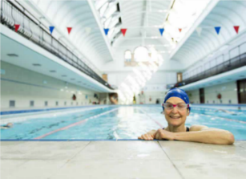
What does existing resident and patient engagement tell us about what matters to residents?
Start well | Live well | Age well
Excess weight in childhood Common childhood illness’ and support for parents Maternity and early years | Employment | Social isolation and loneliness Preventing falls Care at or closer to home Awareness and uptake of support services amongst older Bangladeshi people
Mental health amongst young people including self harm Preventing and proactively managing long term conditions such as asthma Family resilience | Mental health in BAME women during pregnancy and early motherhood Earlier diagnosis of long term conditions and cancer, including through cancer screening, particularly amongst BAME communities Family resilience | Awareness and reducing stigma of mental health and Dementia
Wider determinants :
Food poverty
Affordable, safe and secure housing
Safety and crime
Community cohesion and connectedness
Place/environment and accessibility factors limiting the ability to lead a healthy lifestyle
System related factors:
Communication, coordination and social prescribing
Awareness of available services and support
Accessibility of health and care services

Slide 17
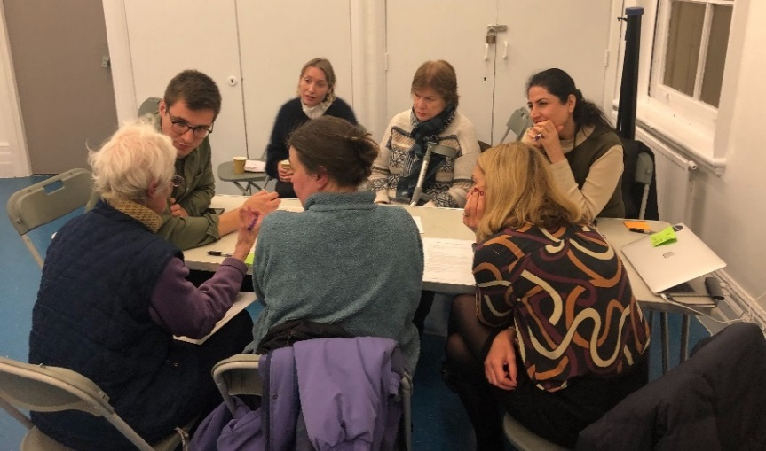
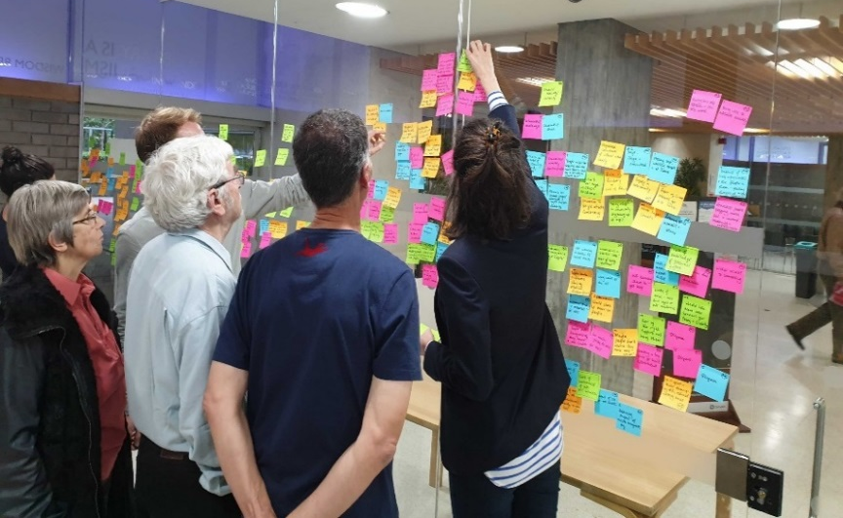
Citizen-led neighbourhood approach to health and wellbeing in the west of Camden: Key issues and themes
Family resilience
Healthy weight, healthy lives
Community connectedness
Ensuring good mental health for all
First 1001 days
Reducing alcohol related harm
Ensuring good mental health for all
Community connectedness
Family resilience

Slide 18
Key reflections
Inequalities in life expectancy in Camden
The JSNA shows general overall improvement in population health in Camden. However, significant health inequalities persist, many of which are related to deprivation. Reducing the gap is likely to require a system focus on particular population groups and wards in the borough, with consideration of what each part of the system can do to better support those most in need and to help prevent factors contributing to health inequalities.
Residents’ voice/views, coupled with our data insights, underline the importance of a continued focus on the wider determinants of health to help improve overall health and wellbeing in Camden by enhancing the conditions into which people are born, live and age.
The majority of health and care system resource is related to immediately presenting need. In order to shift the curve and prioritise prevention and early intervention, we need to consider the balance between shorter and longer term priorities.
Clustering of risk factors and of disease/multi morbidity requires a different, more holistic approach – move away from considering unhealthy behaviours or physical or mental health conditions in isolation.

Slide 19
Key reflections
Although we have seen improvements across a number of areas of child health, inequalities are marked amongst this group, with deprivation and/or ethnicity a key factor for issues such as obesity, long term conditions and social needs. Addressing this inequality is fundamental to ensuring all children in Camden are able to get the best start in life, and to achieve good health and wellbeing outcomes throughout their lives.
Despite the relatively high proportion of Camden’s population which fall into the ‘live well’ segment, historically, we have arguably taken less of a system focus on working age adults. When considering a life course approach, this group presents a key opportunity to support healthy ageing through prevention.
Whilst in the context of the whole Camden population, those with complex health needs or severe frailty is a relatively small group, they make up the largest proportion of the older adult population. Providing a more integrated and community based response for this cohort is critical.

